Slide 1
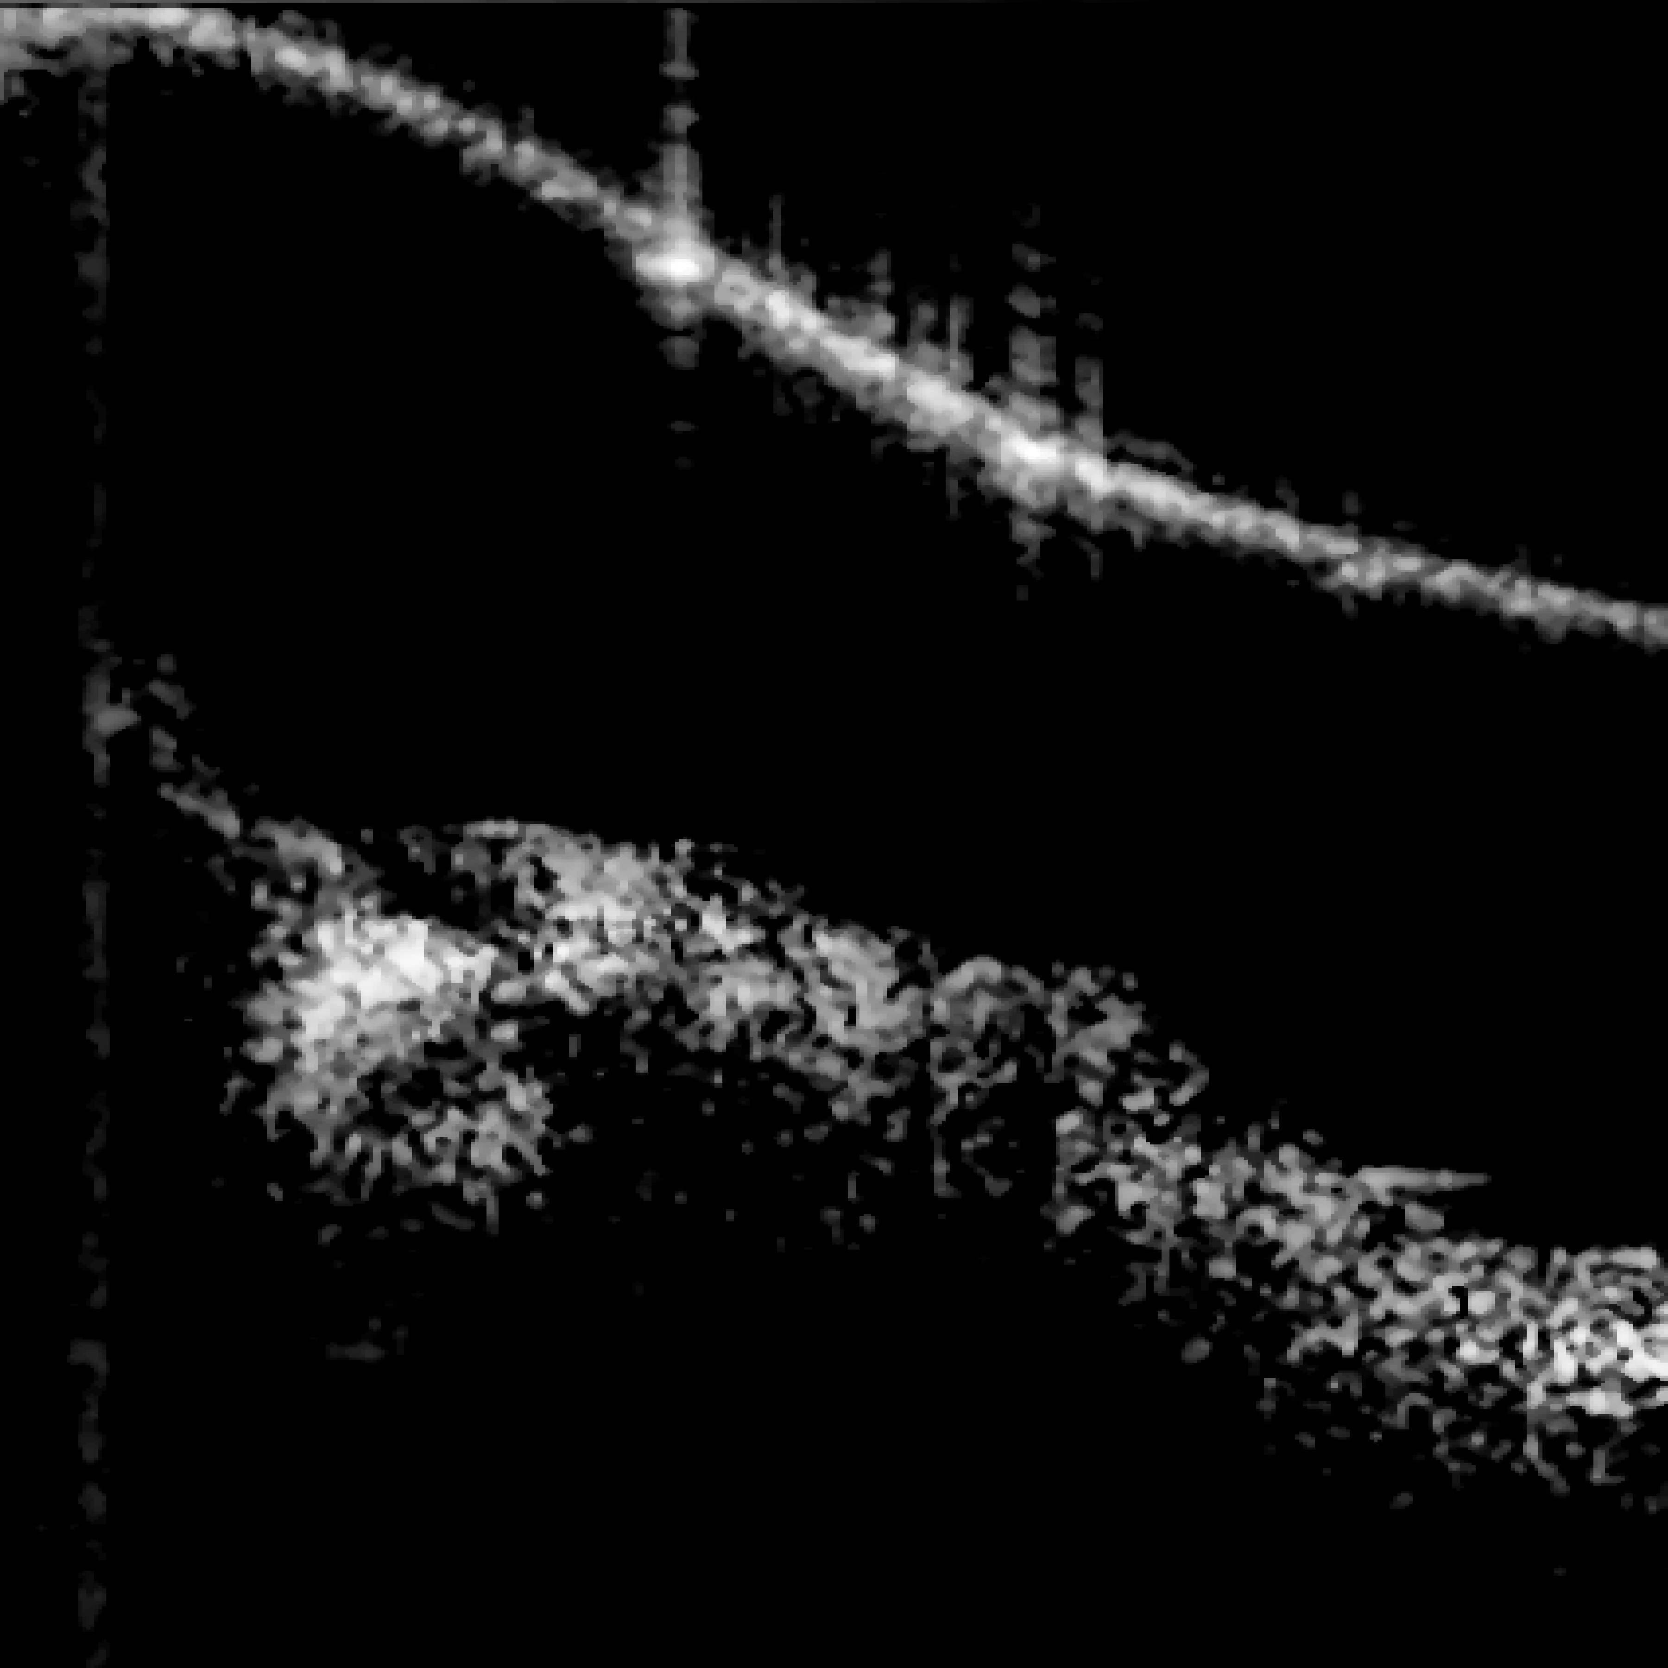
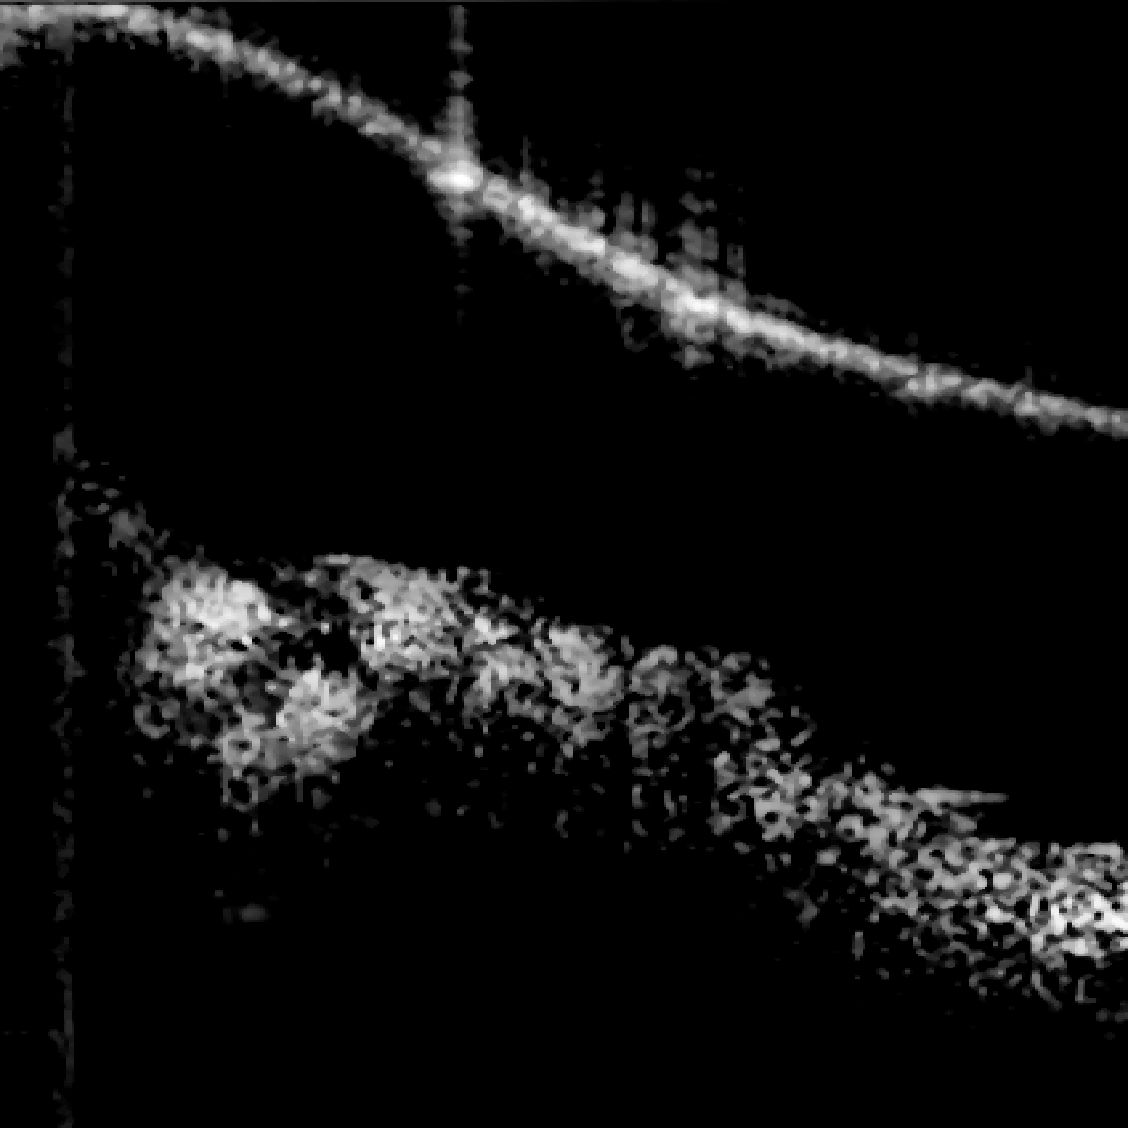
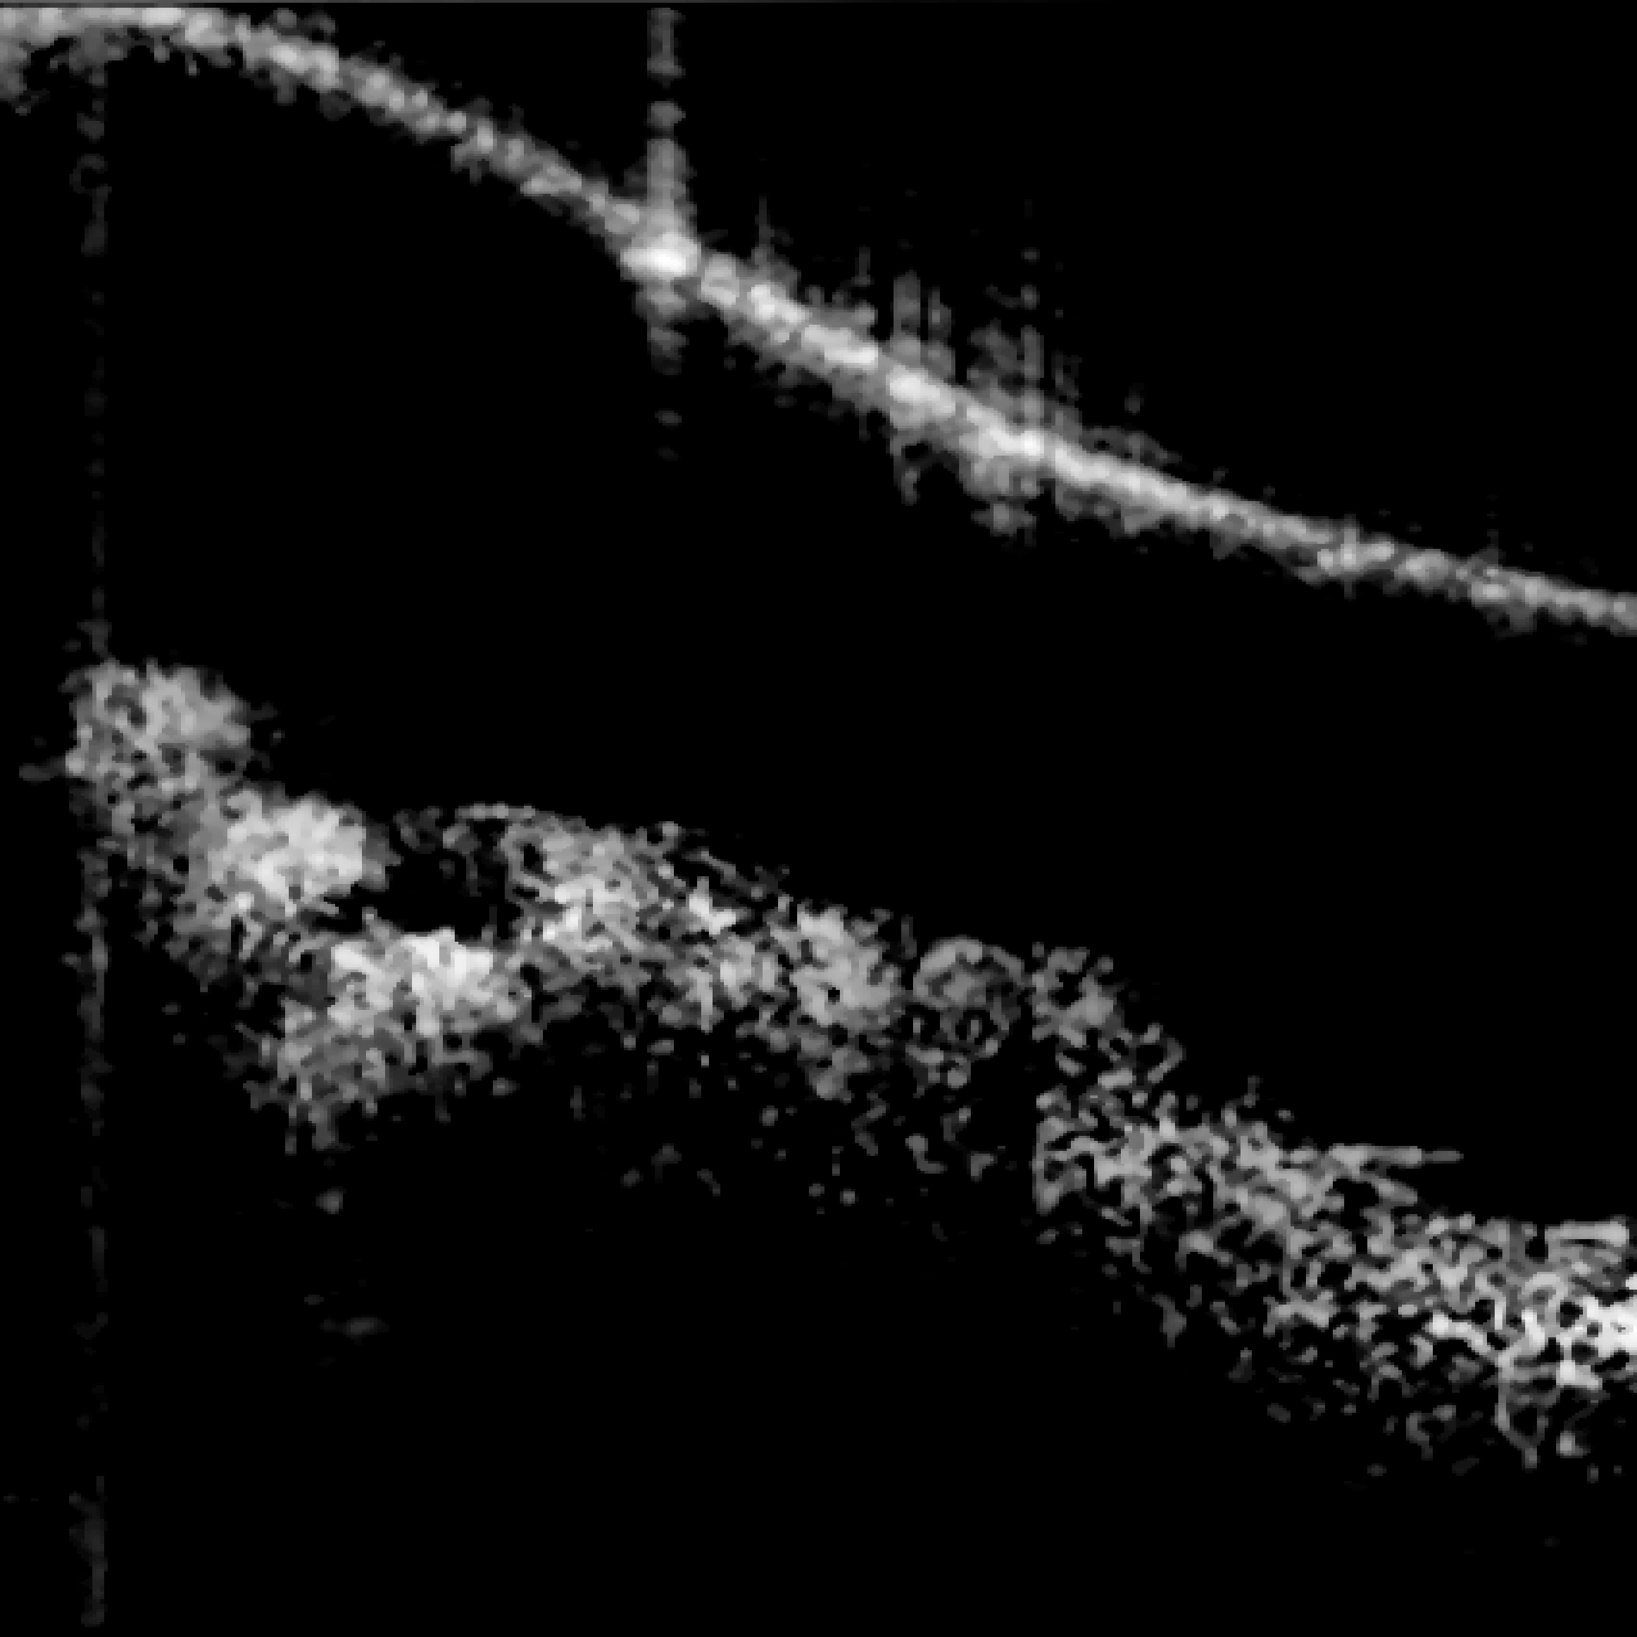
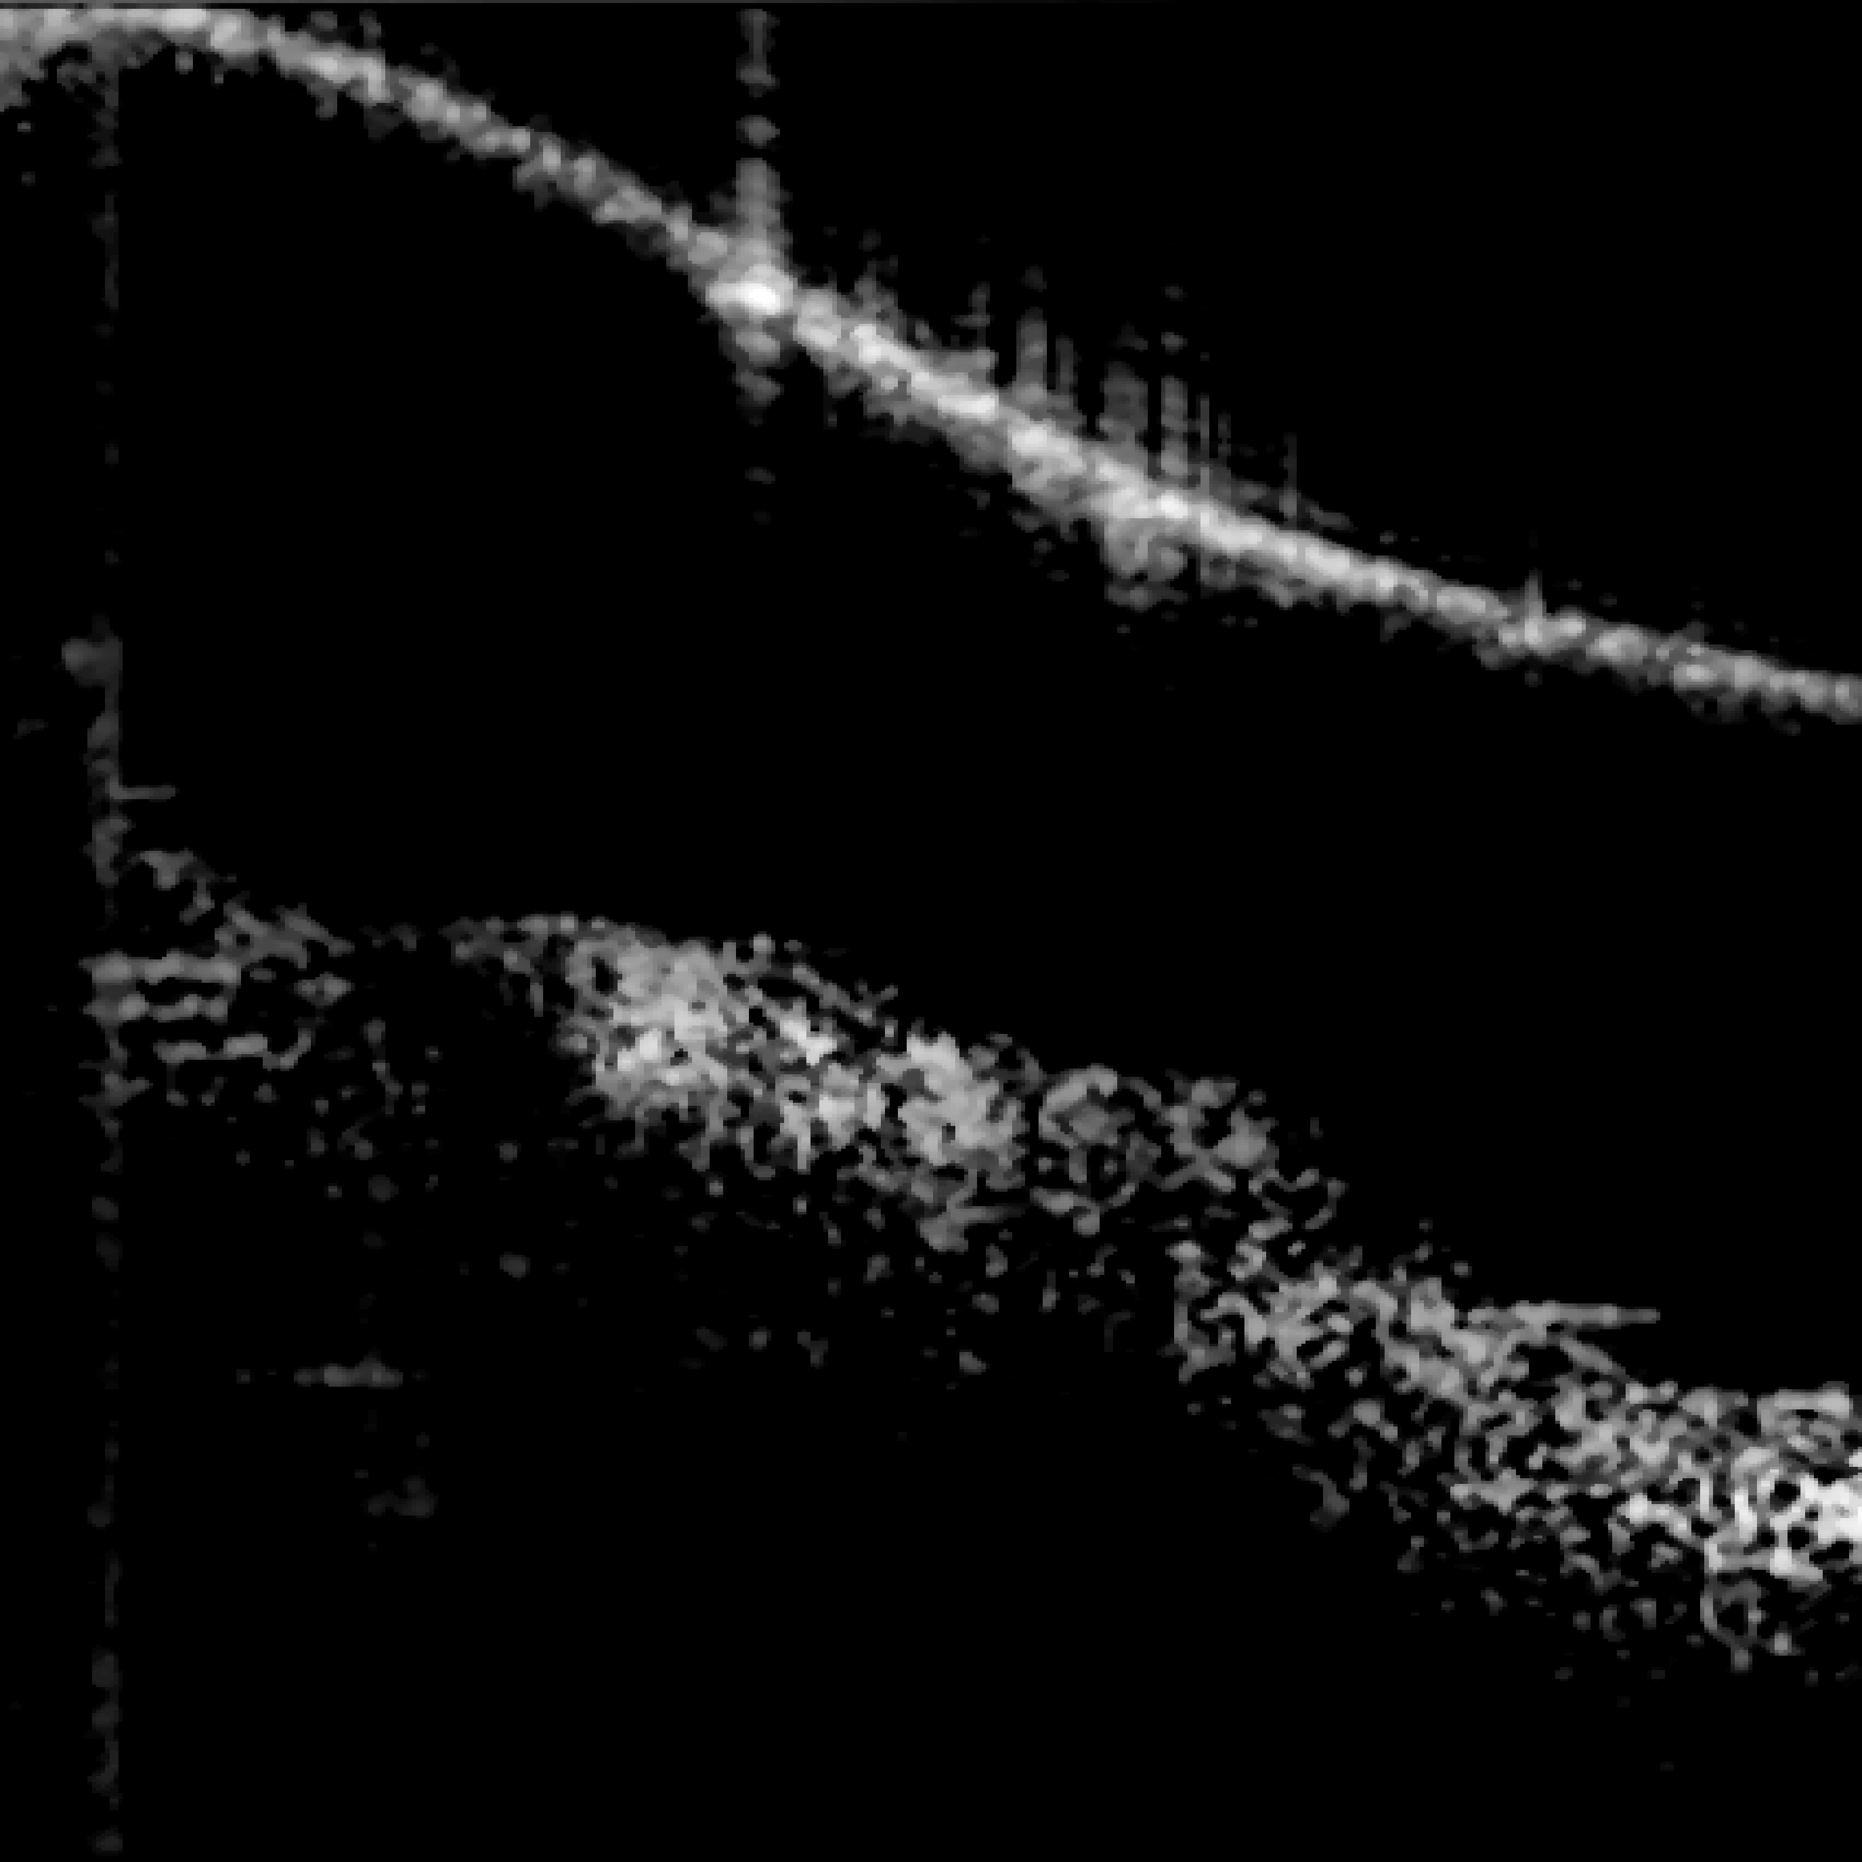
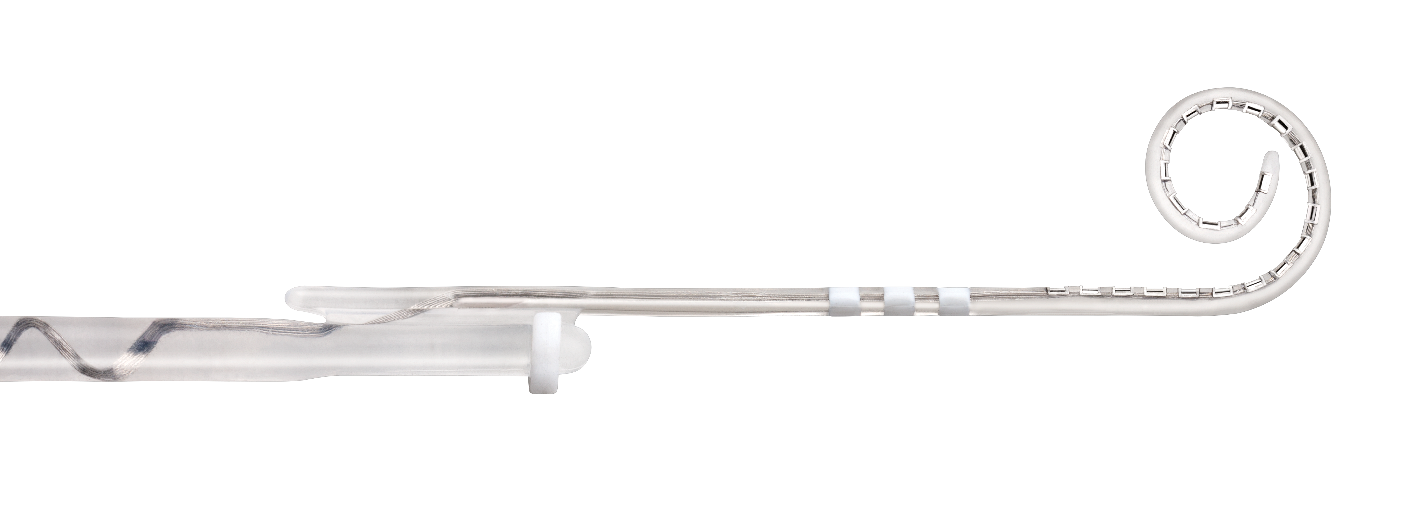
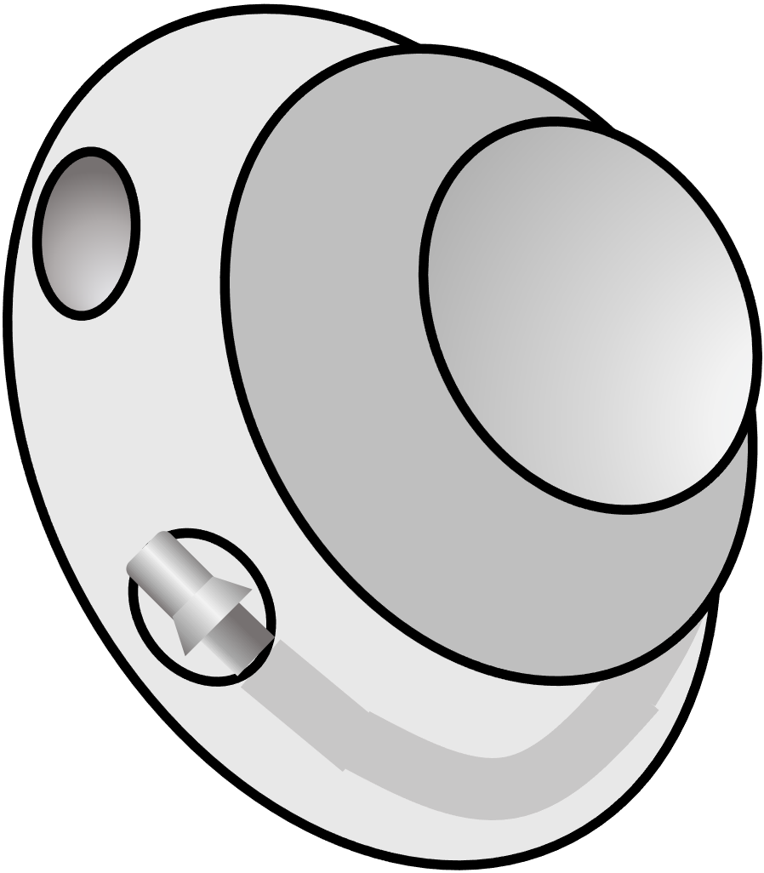
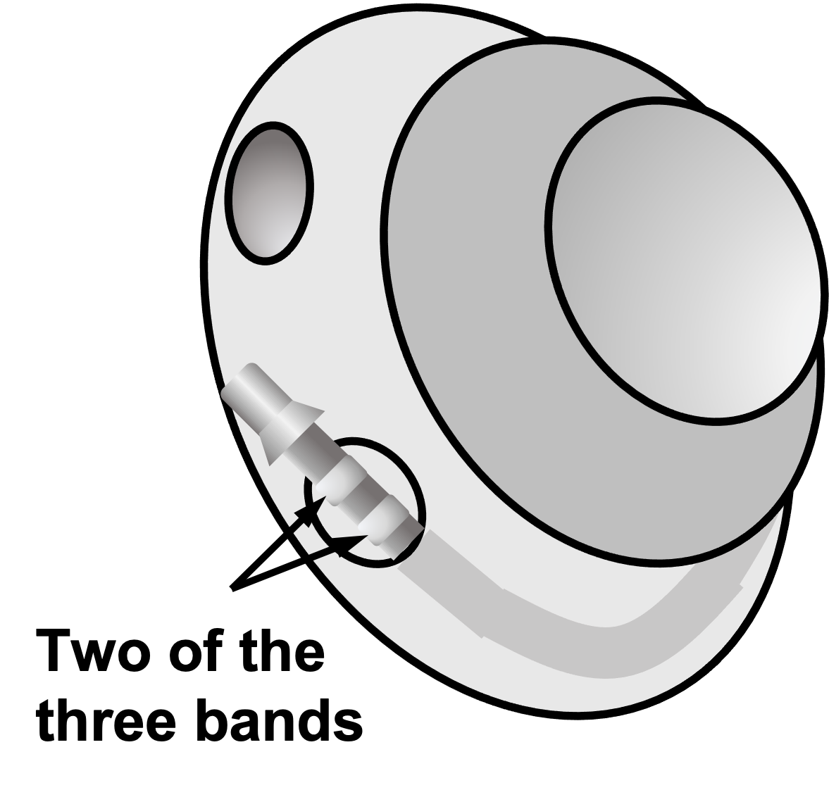
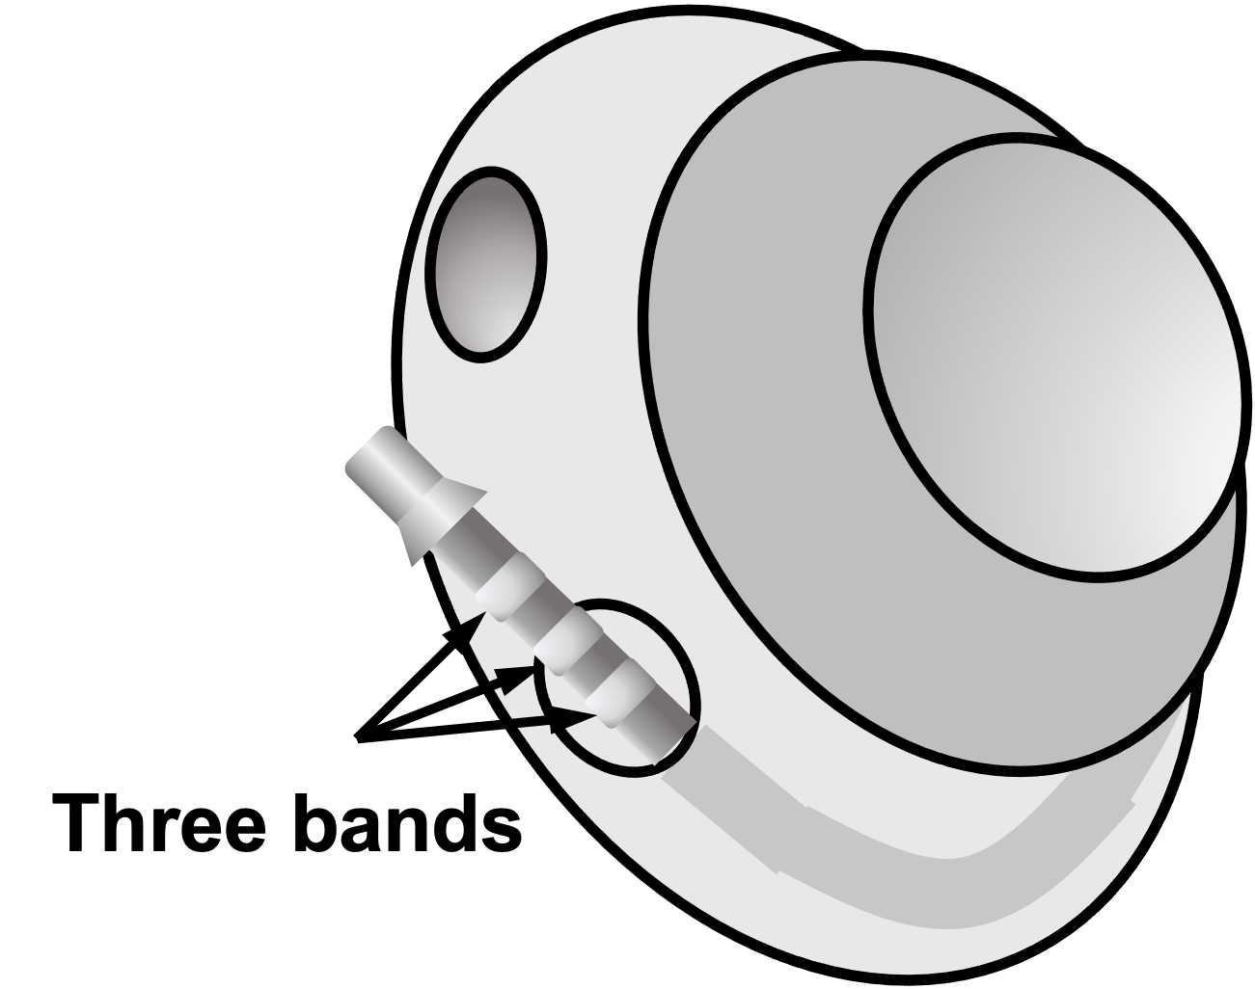
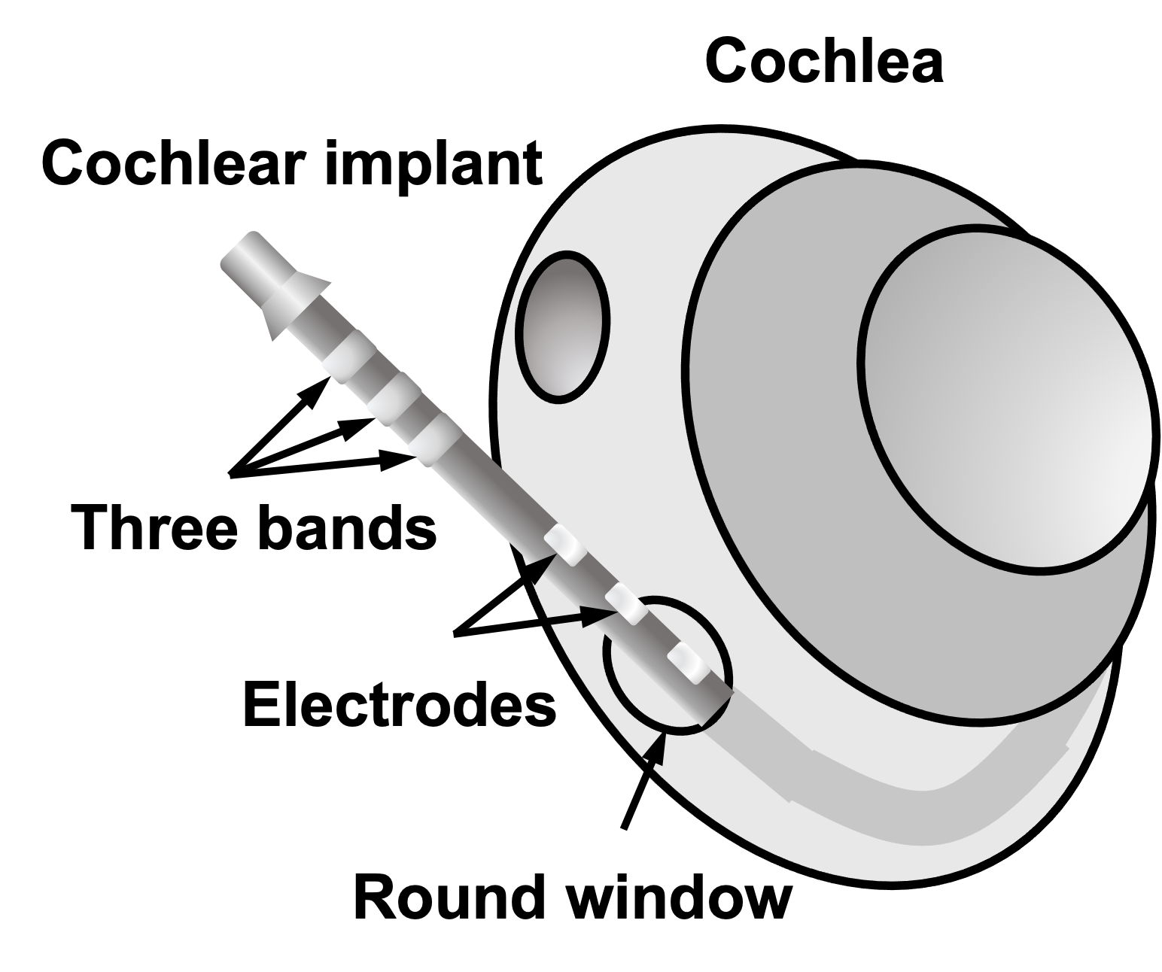
(A) Full Insertion
(B) Partial Insertion I
(C) Partial Insertion II
(D) Complete Migration
(E) CI532

Slide 2
(A) Full Insertion
(B) Partial Insertion I
(C) Partial Insertion II
(D) Complete Migration
(E) CI532

Slide 3
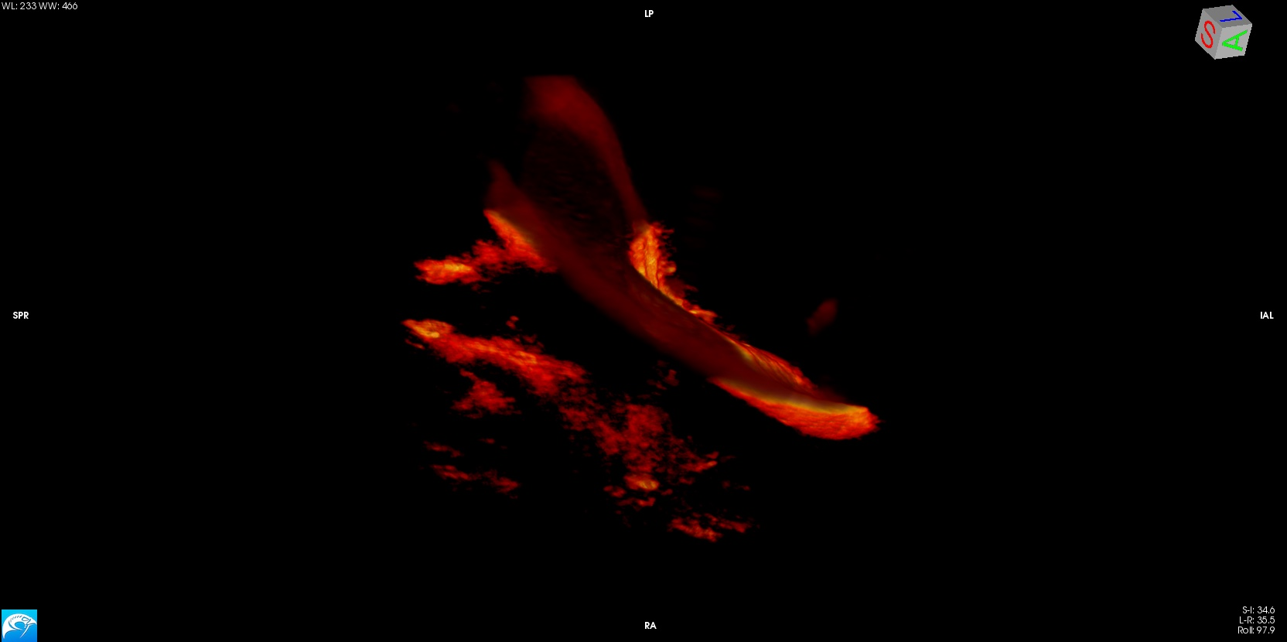
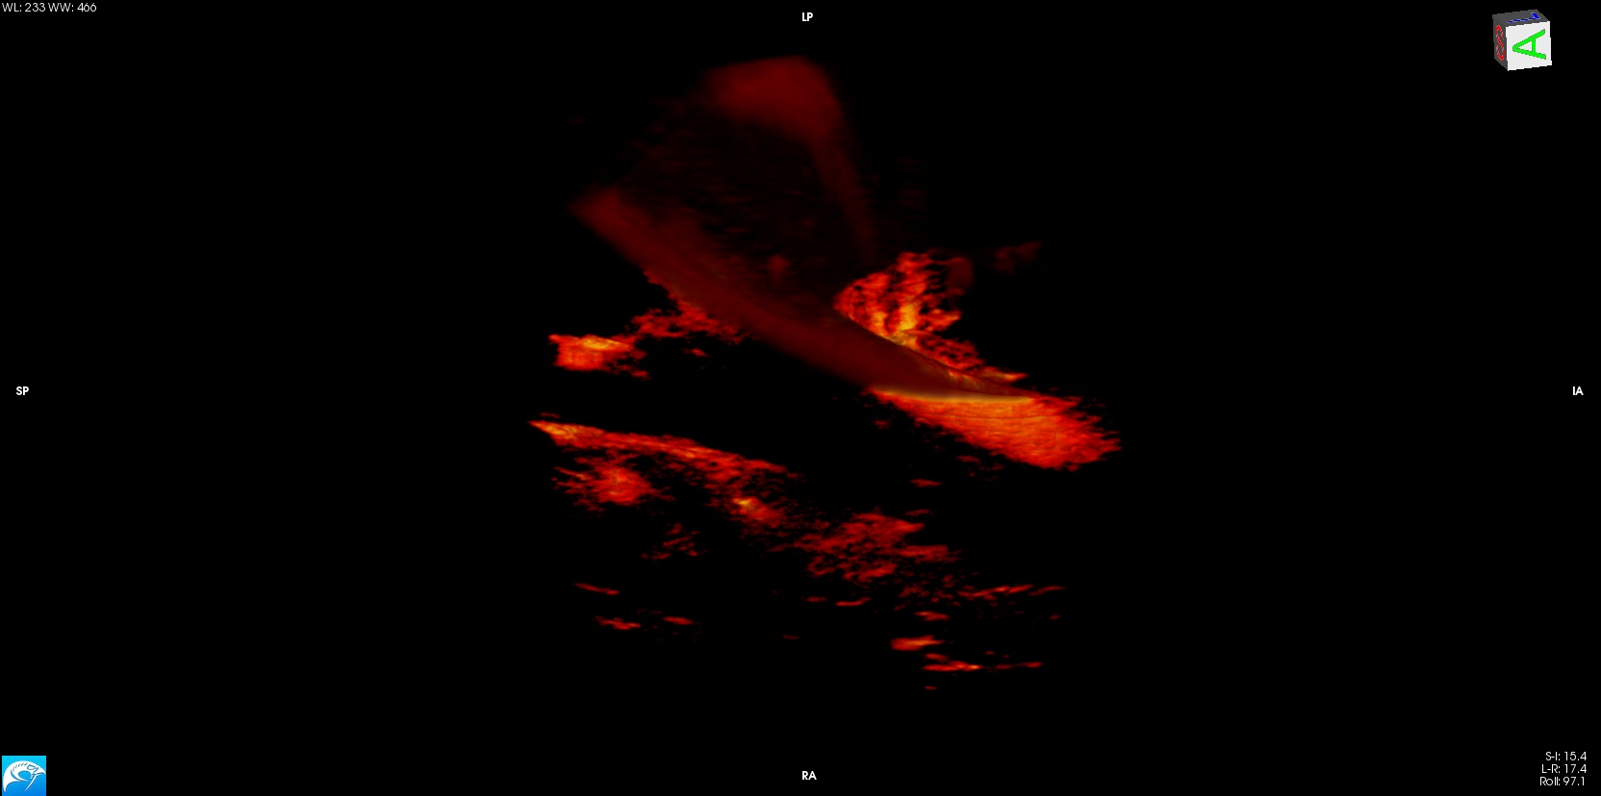
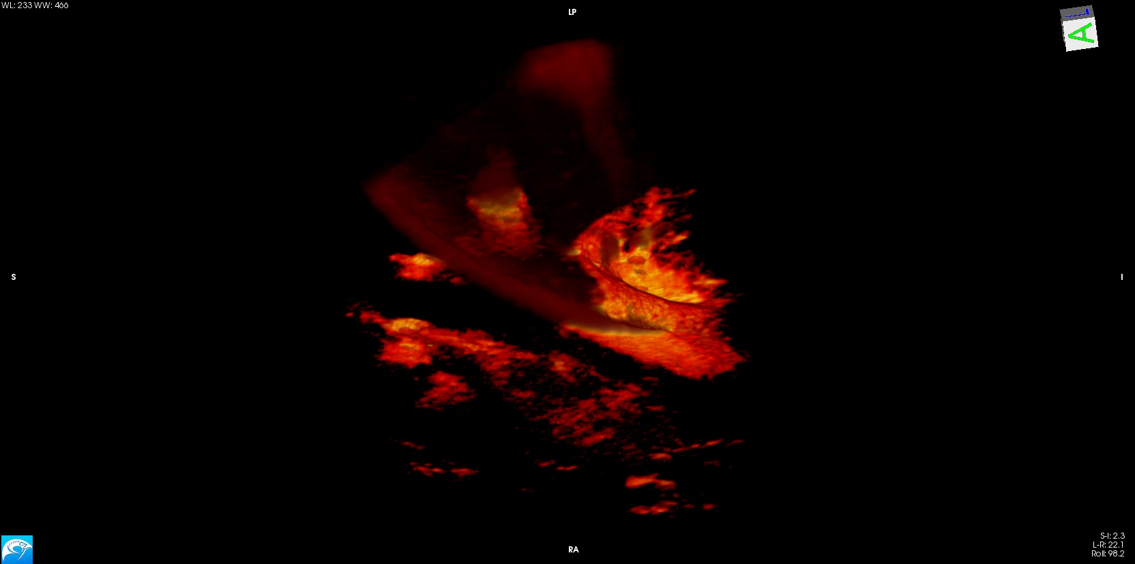
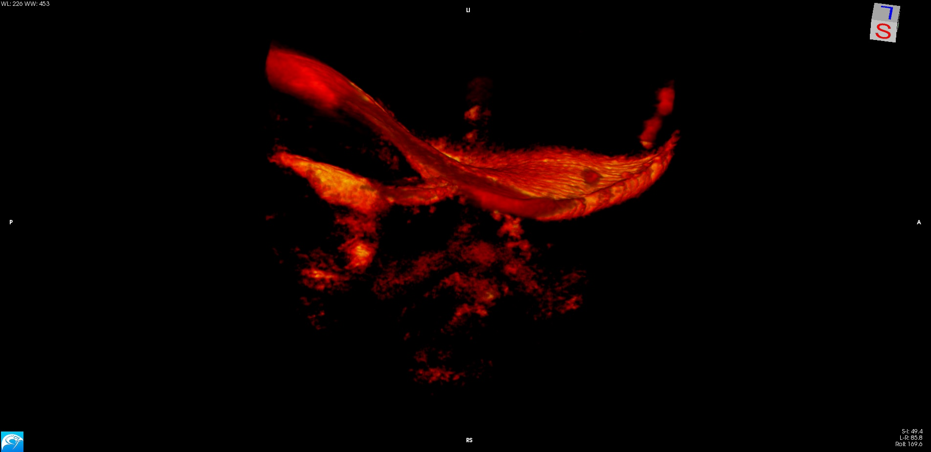
(A) Full Insertion
(B) Partial Insertion I
(C) Partial Insertion II
(D) Complete Migration
(E) CI532
TM
CP
markers
ST
RW
TM
CP
markers
2.4 mm
M

Slide 4
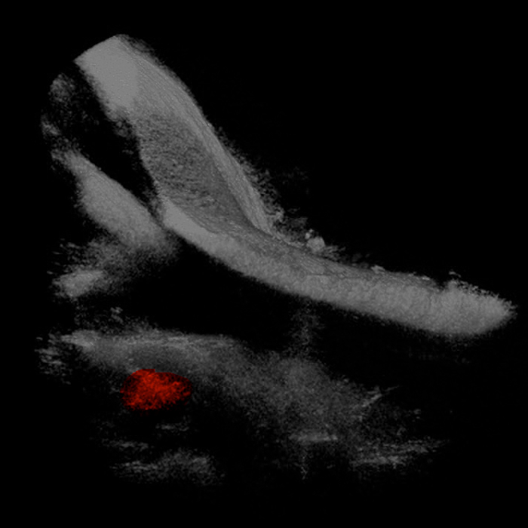
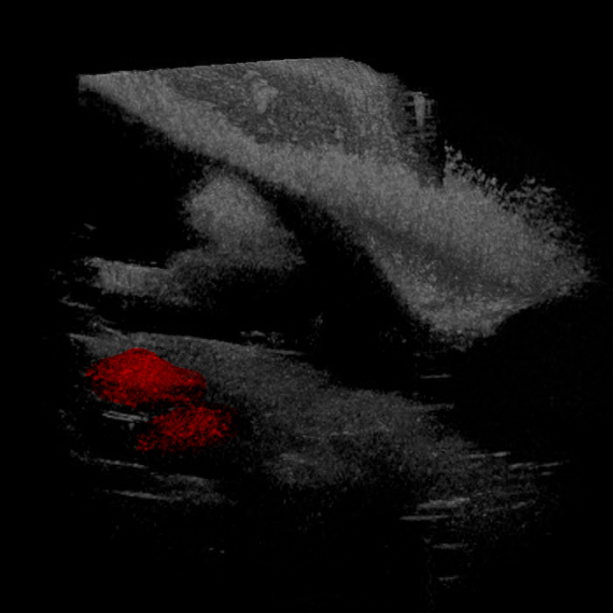
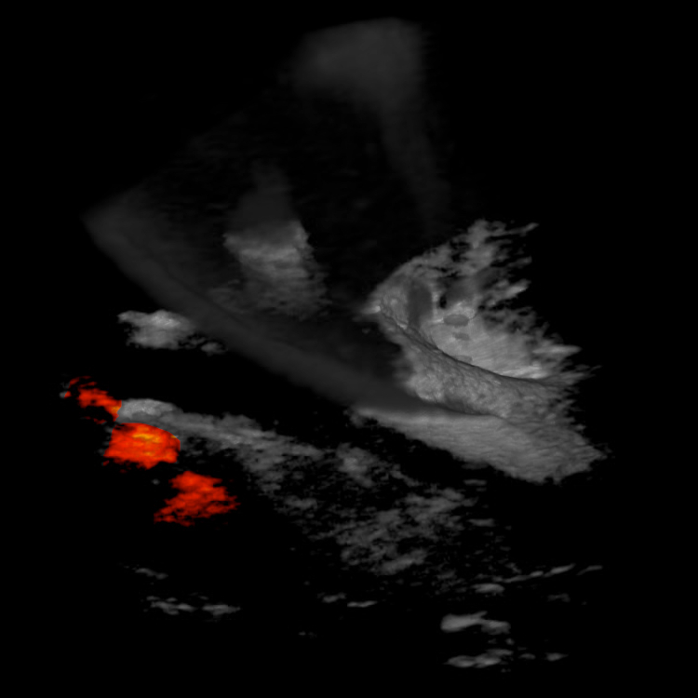
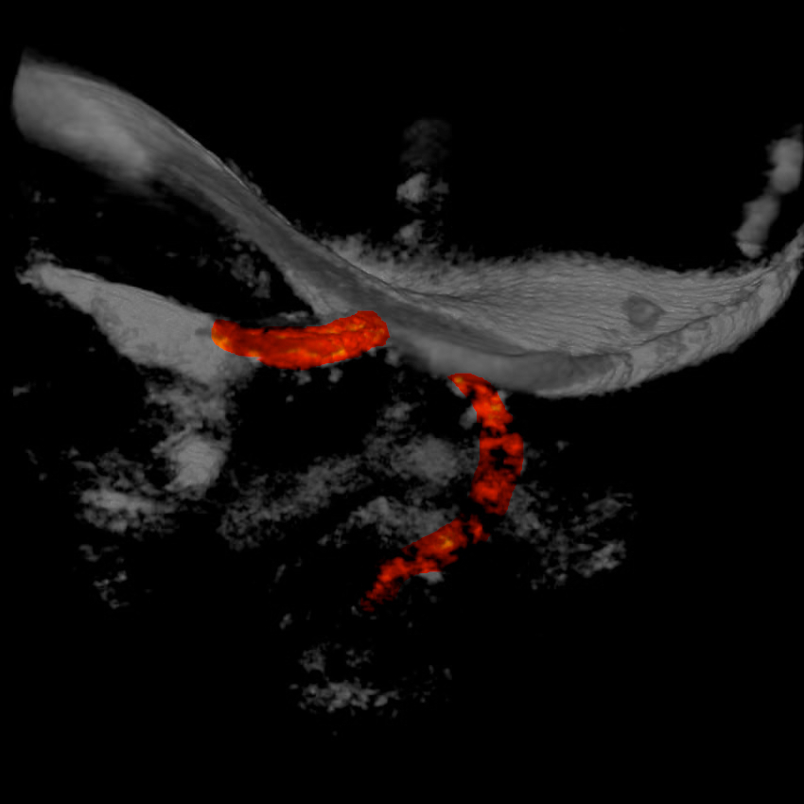

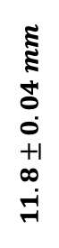

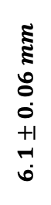


(A) Full Insertion
(B) Partial Insertion I
(C) Partial Insertion II
(D) Complete Migration
$$y$$
$$x$$
TM
1
$$11.8±0.04 mm$$
CP
$$x$$
$$z$$
markers
$$6.1±0.06 mm$$
TM
2
ST
CP
2.9 mm
M
RW
3

Slide 5
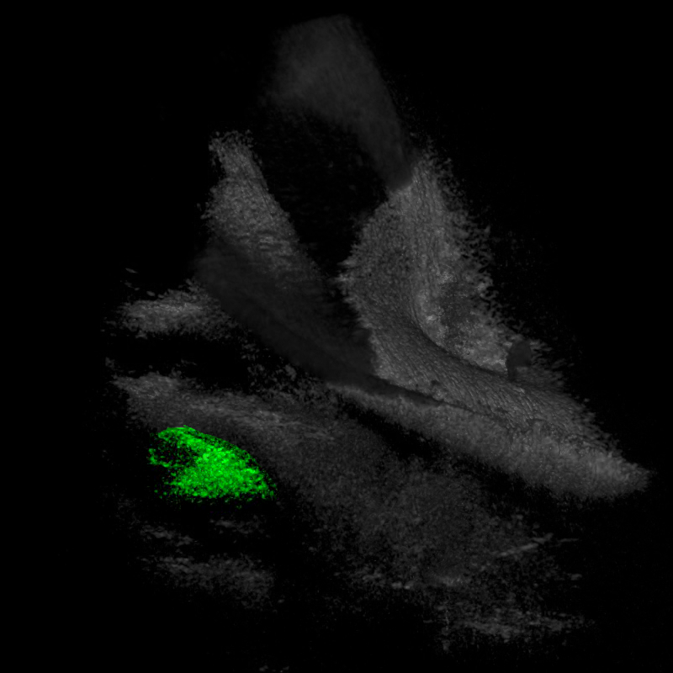
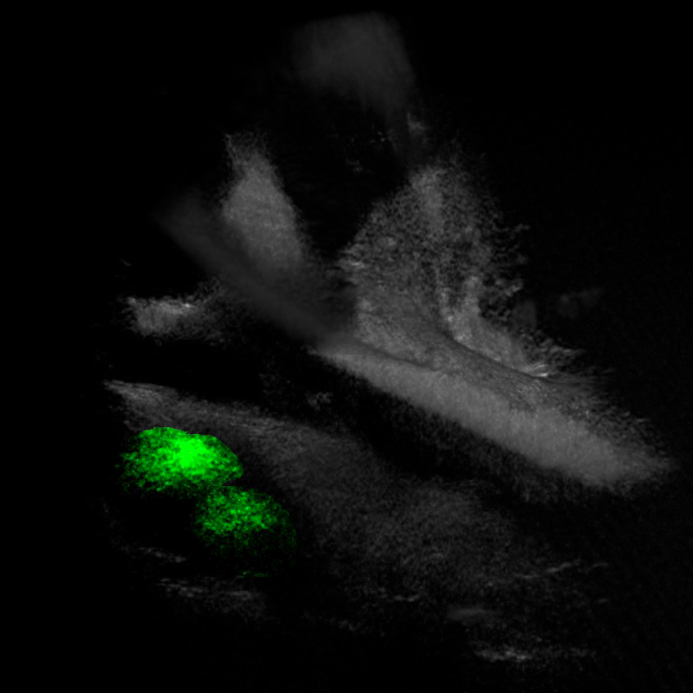
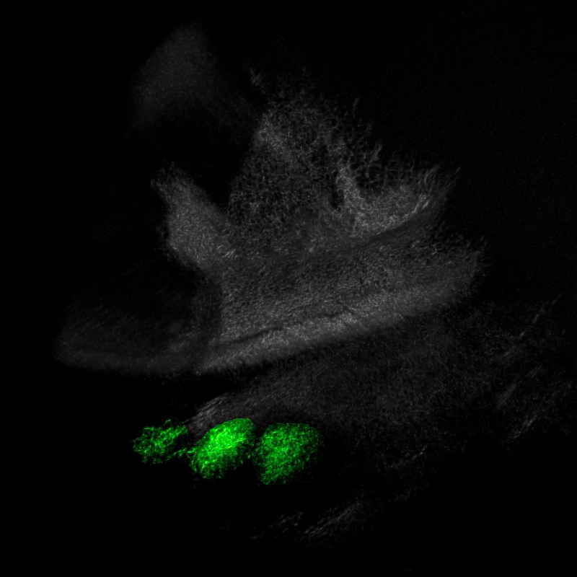
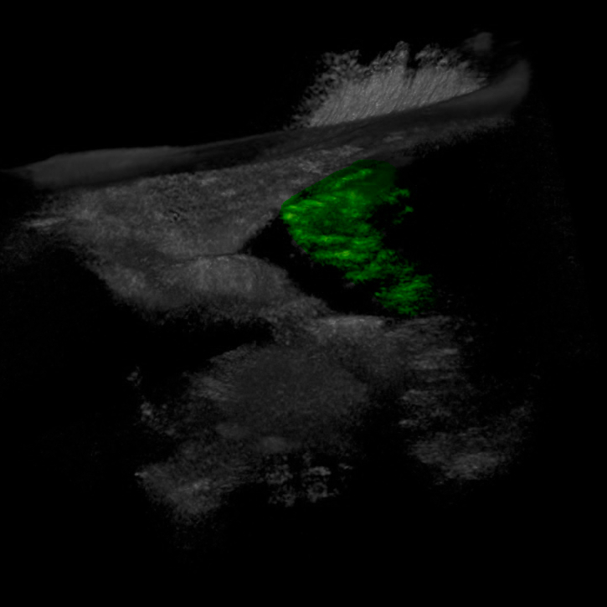
(A) Full Insertion
(B) Partial Insertion I
(C) Partial Insertion II
(D) Complete Migration
(E) CI532
TM
CP
markers
TM
ST
markers
2.9 mm
M
RW
CP

Slide 6
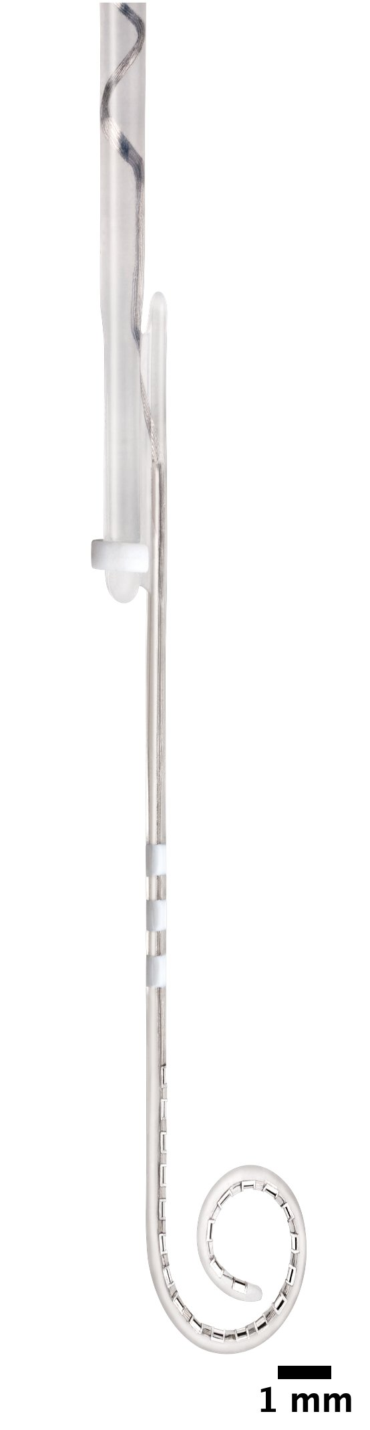
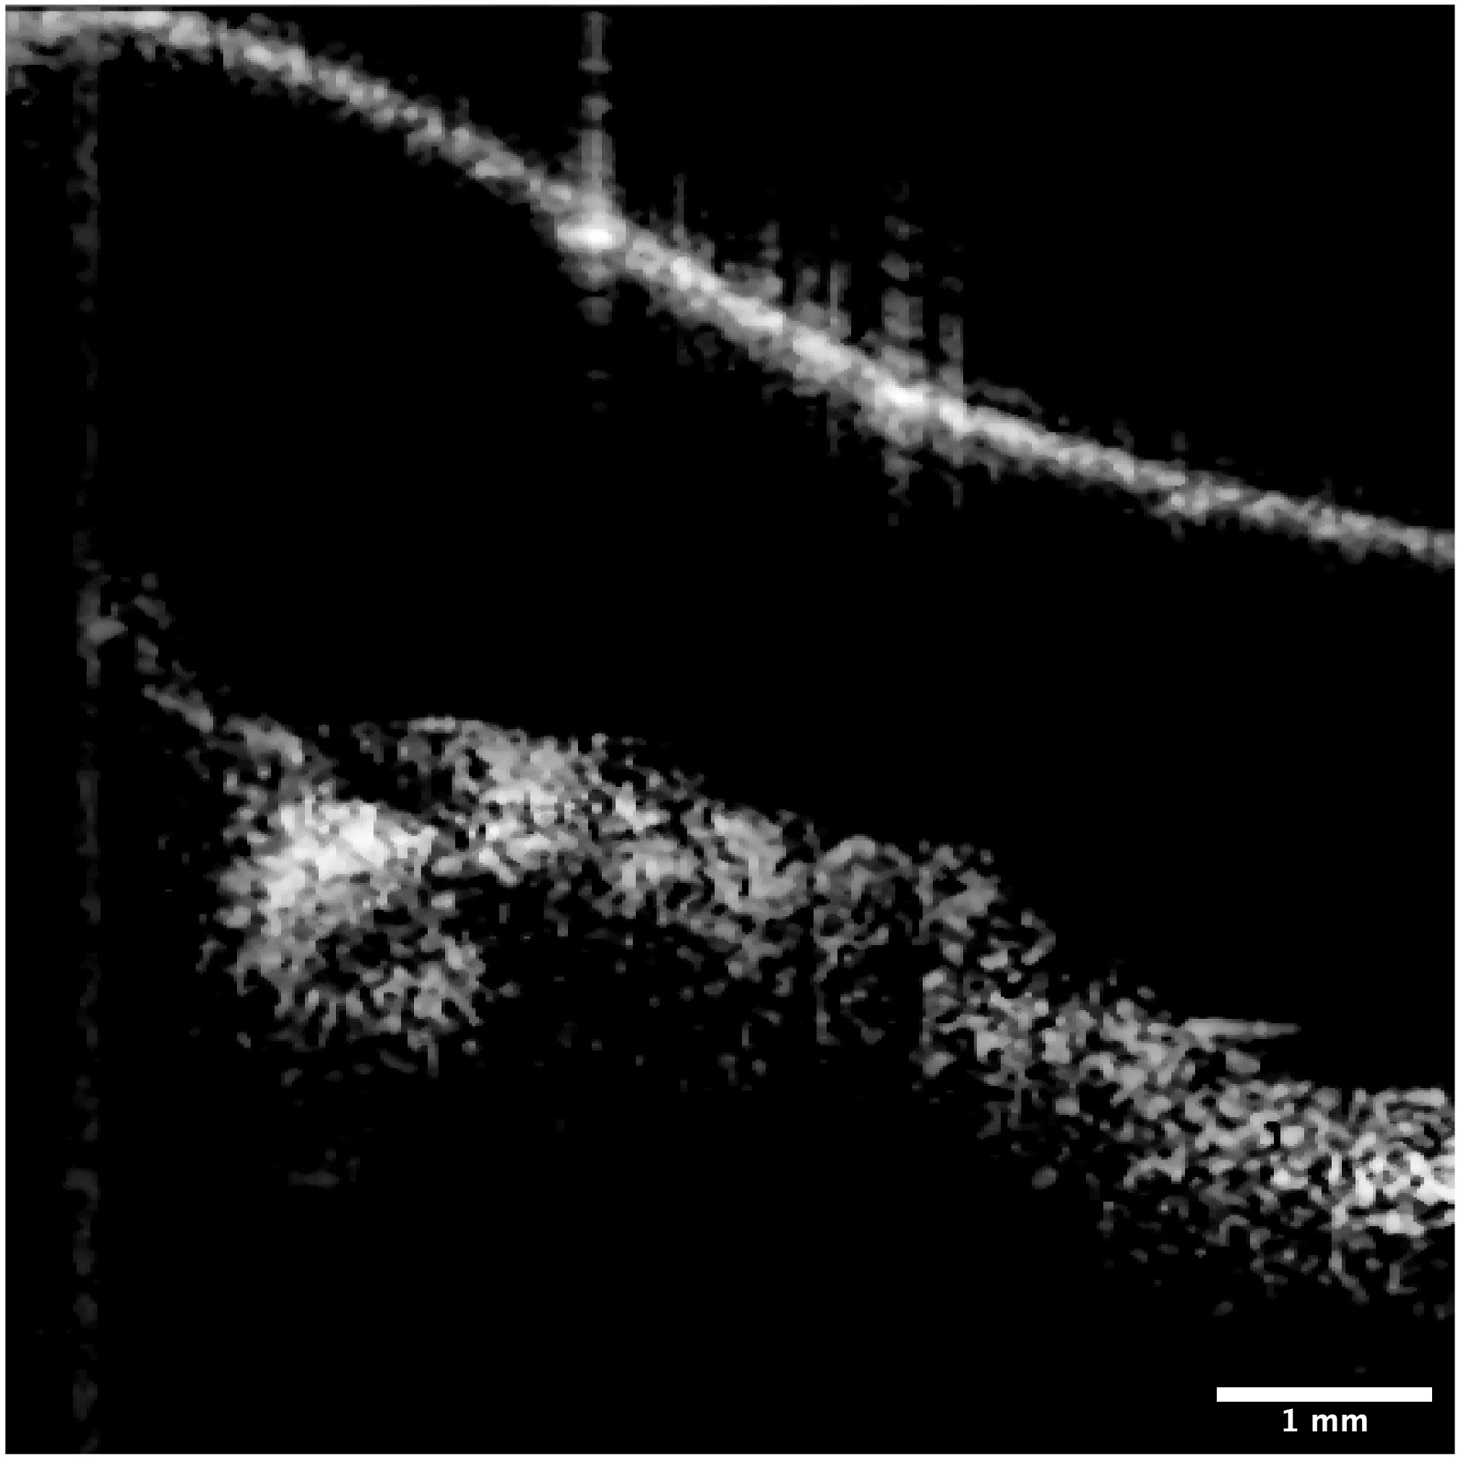
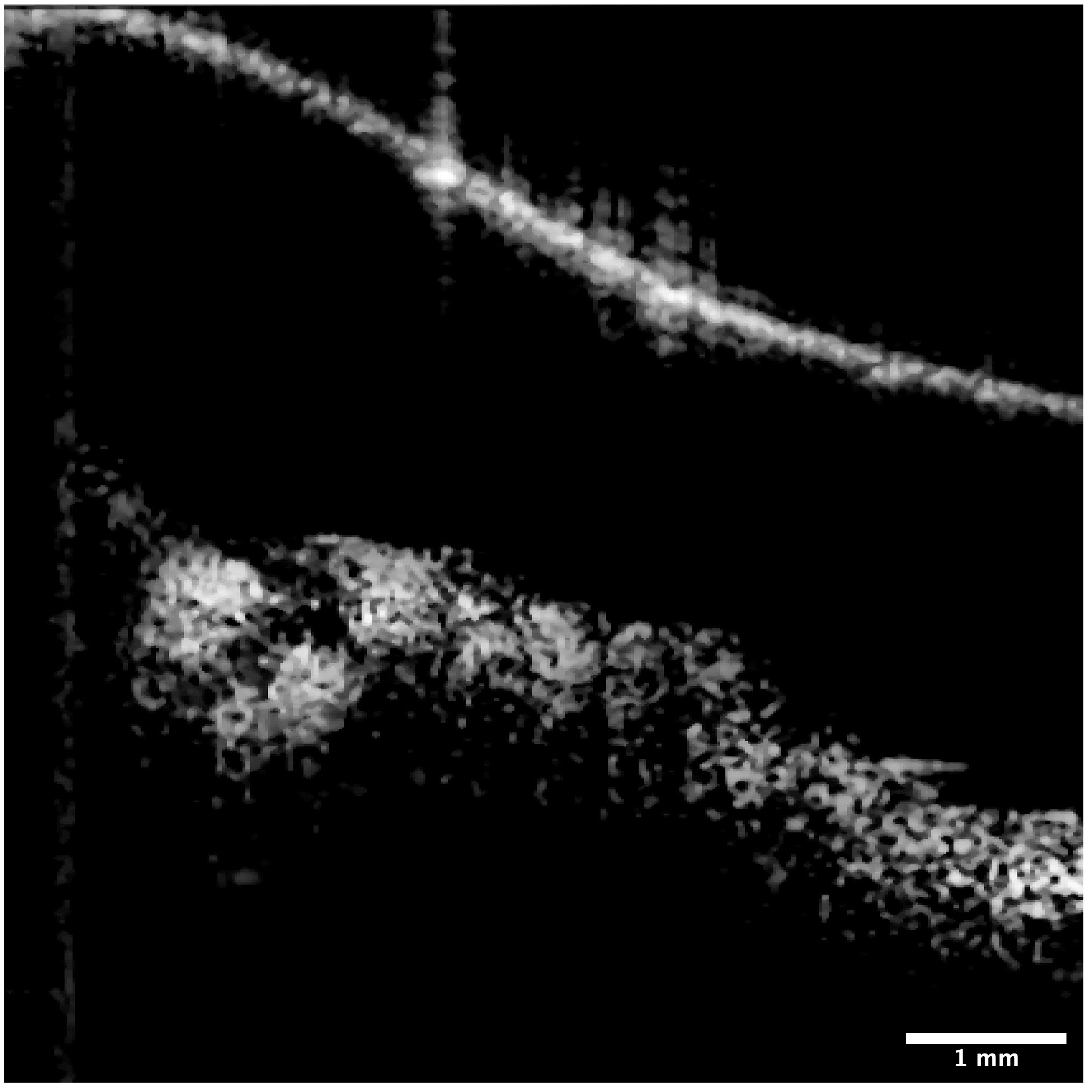
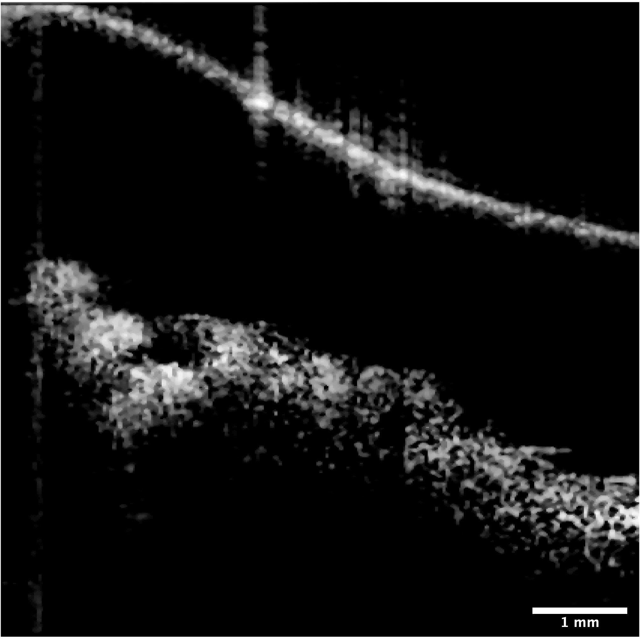
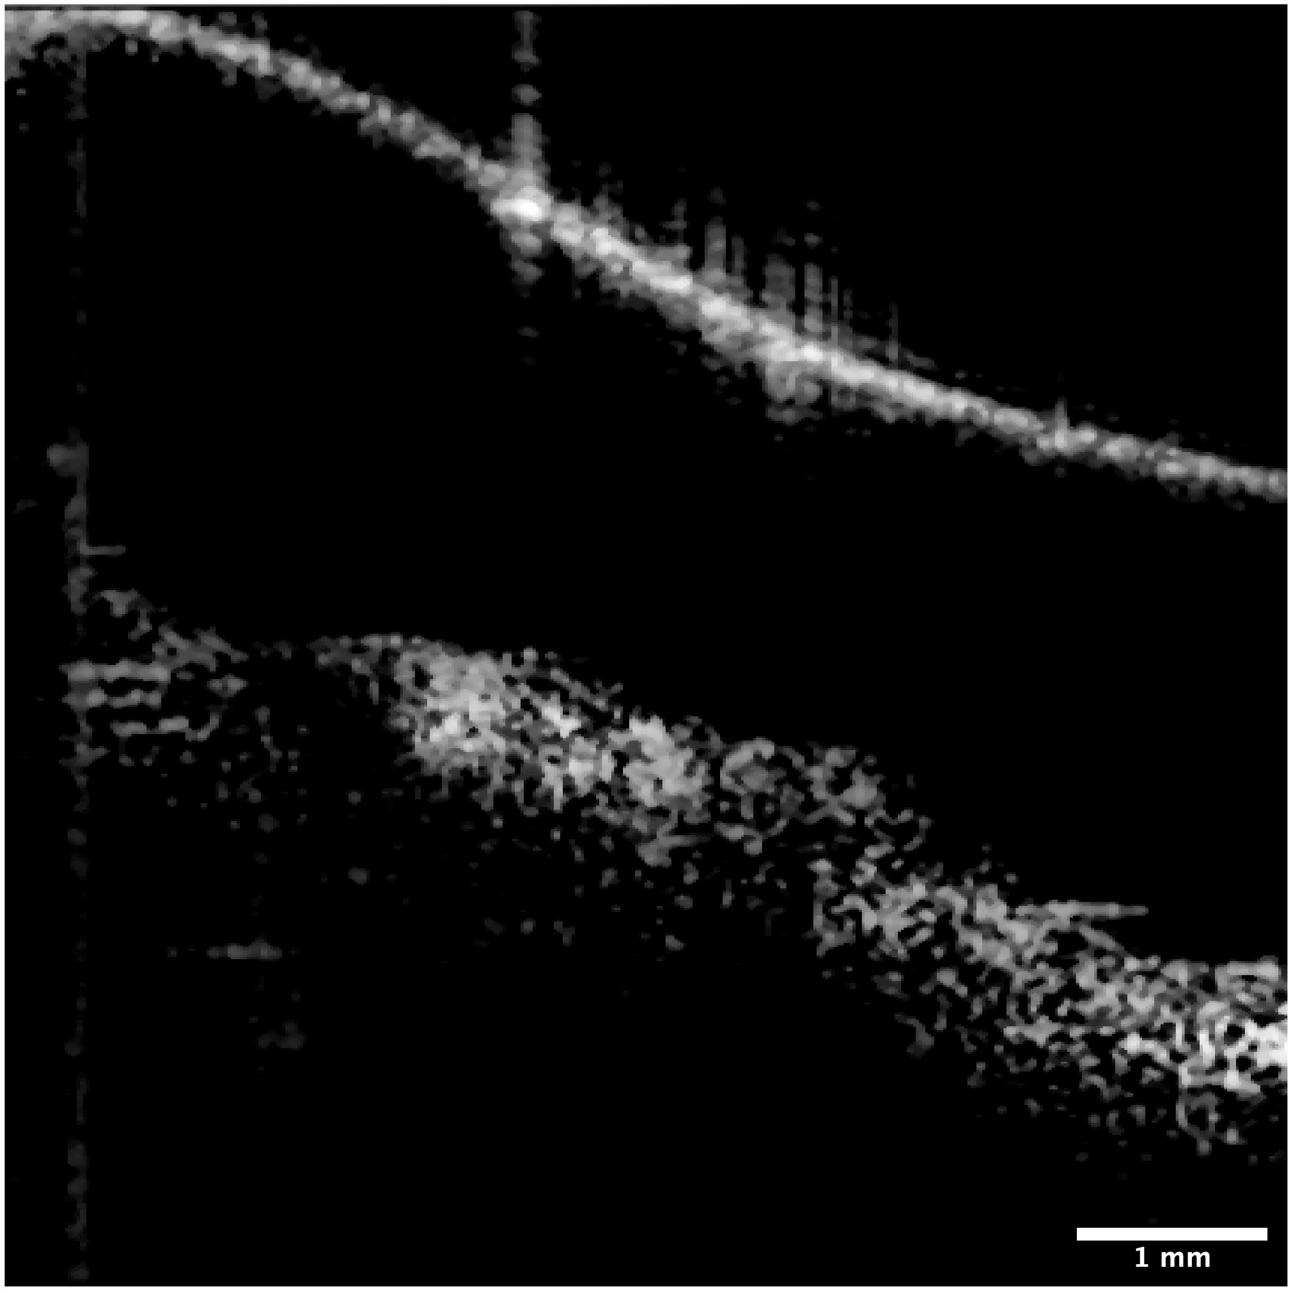
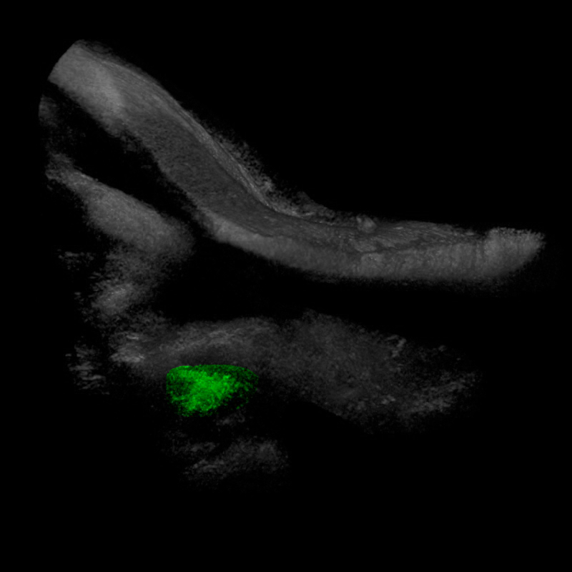
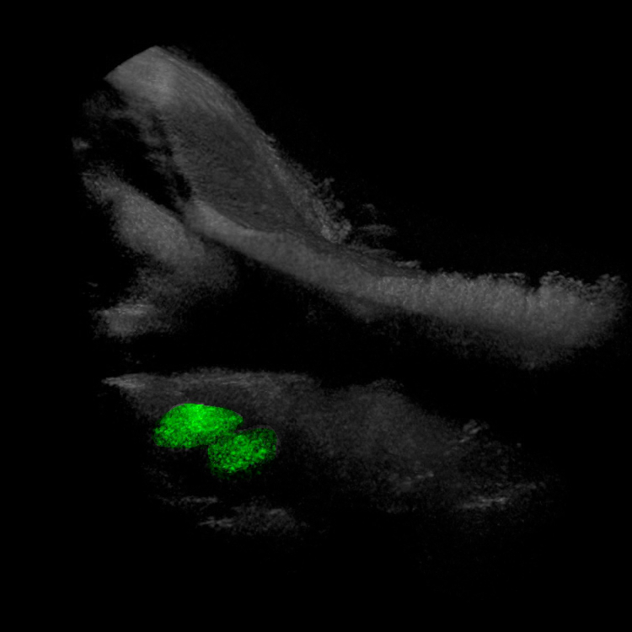
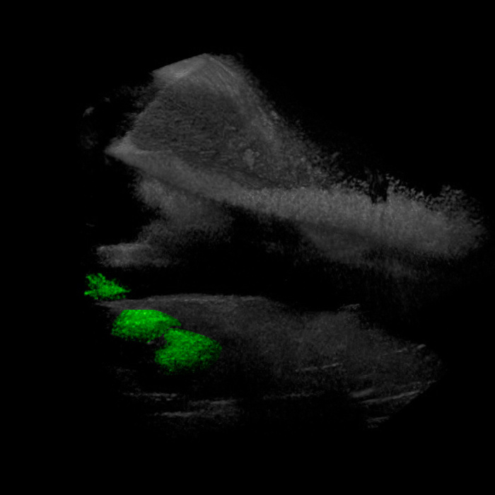
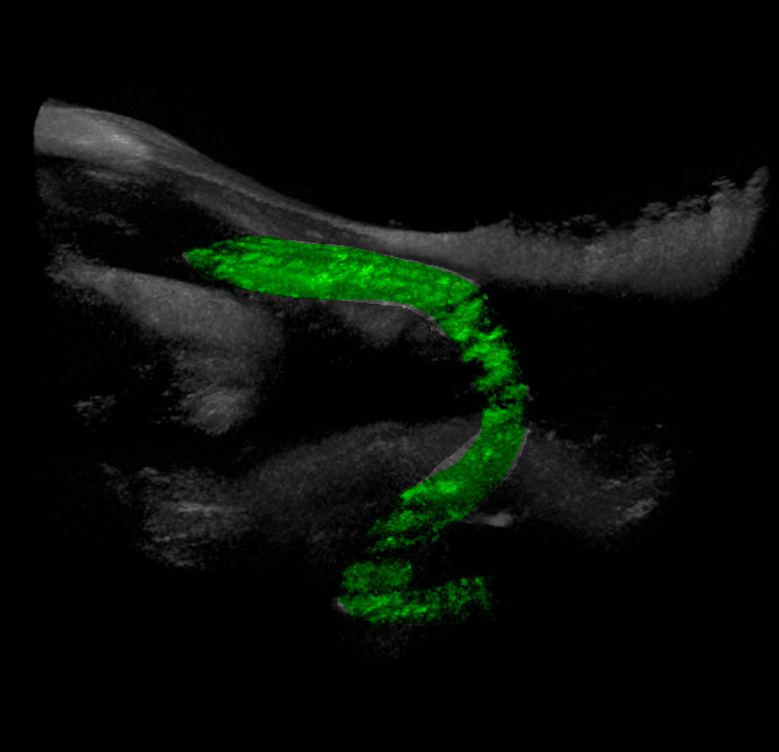
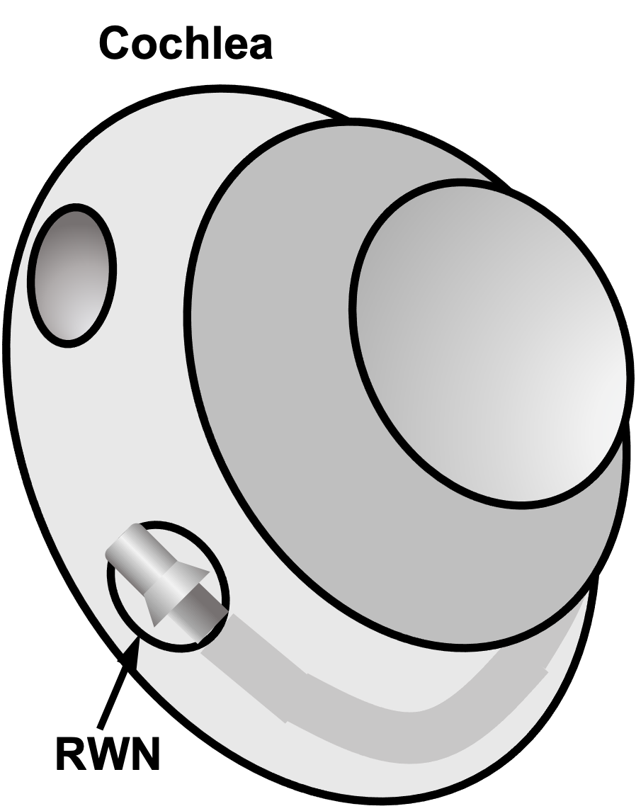
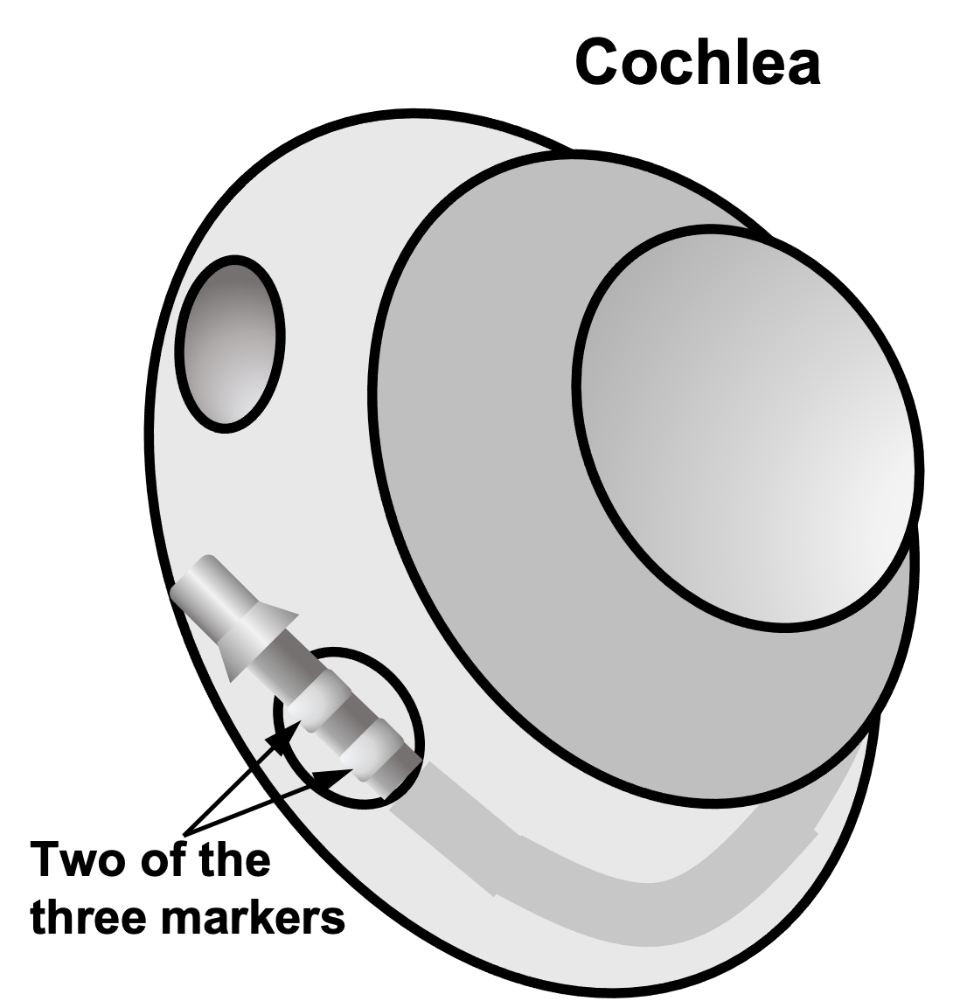
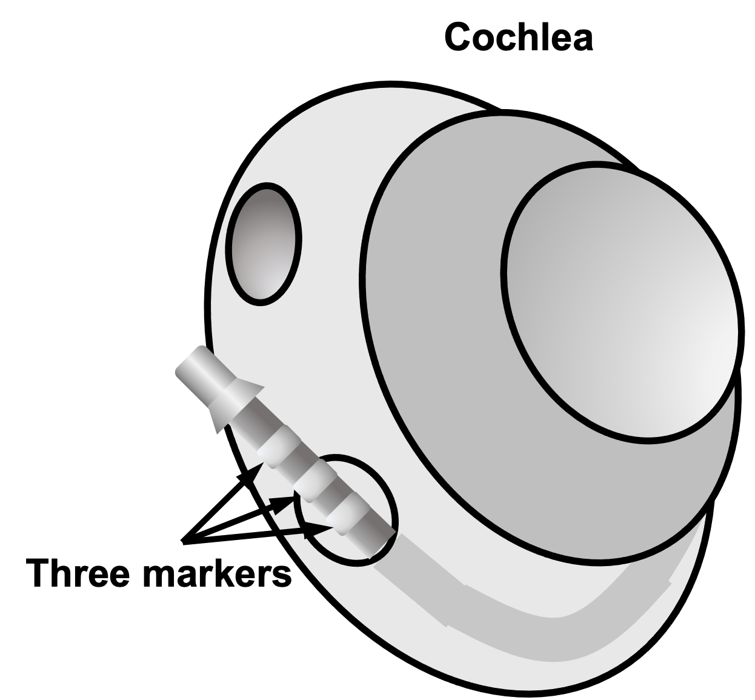
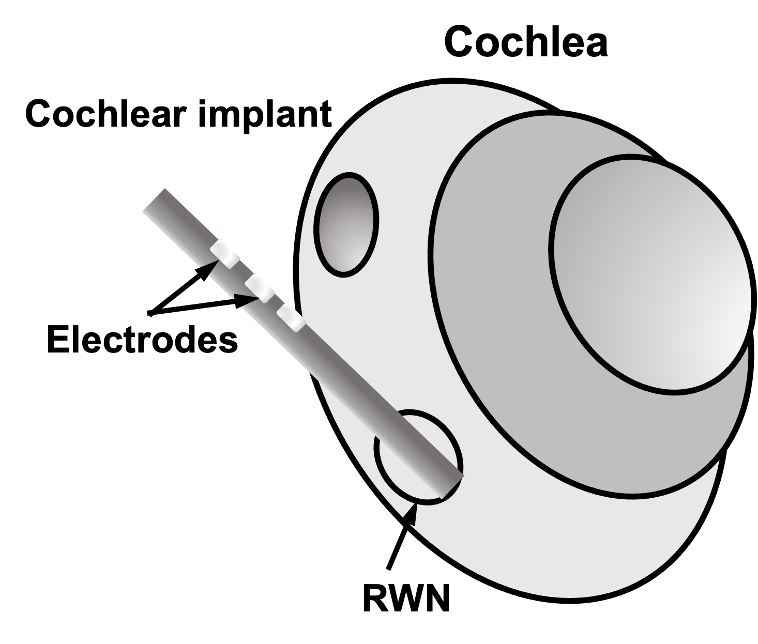







Cochlear Slim Modiolar electrode
(A) Full Insertion
(B) Partial Insertion I
(C) Partial Insertion II
(D) Complete Migration
(E) Slim Modiolar Electrode
Cochlear Slim Modiolar electrode
1
white alignment maker
2
three white insertion
depth markers;
distance between white markers – 1mm
3
electrode tip; distance
to most proximal white marker – 18.4 mm
$$y$$
$$x$$
TM
TM
TM
TM
RWN
CP
RWN
RWN
RWN
CP
1
CP
CP
$$x$$
6 mm
$$z$$
2
TM
TM
M
TM
1 mm
I
TM
2
I
ST
ST
I
ST
2.9 mm
Umbo
Umbo
CP
CP
CP
RWN
CP
$$x$$
RWN
CP
RWN
$$z$$
$$y$$
3

Slide 7
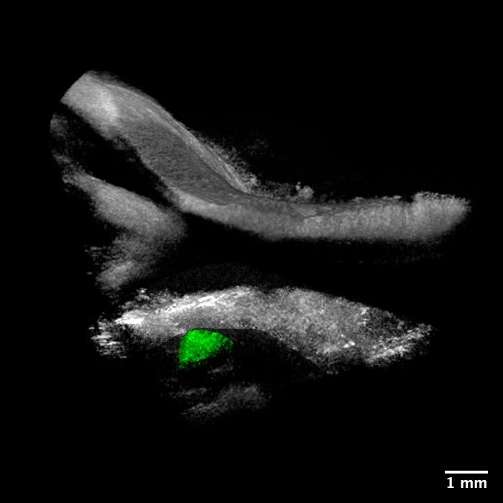
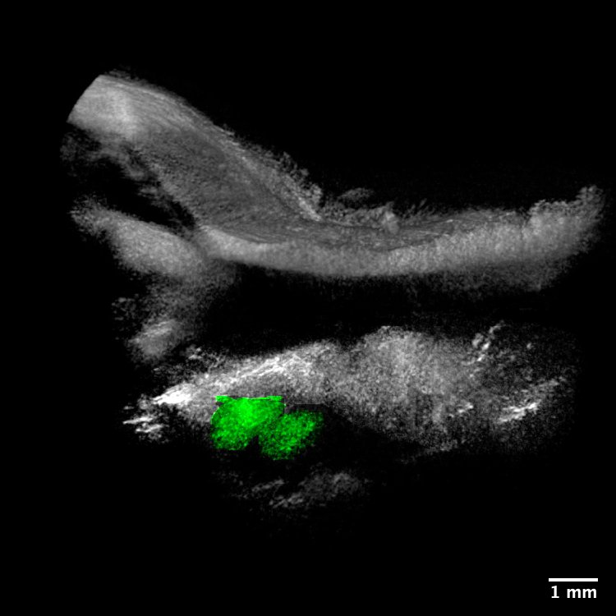
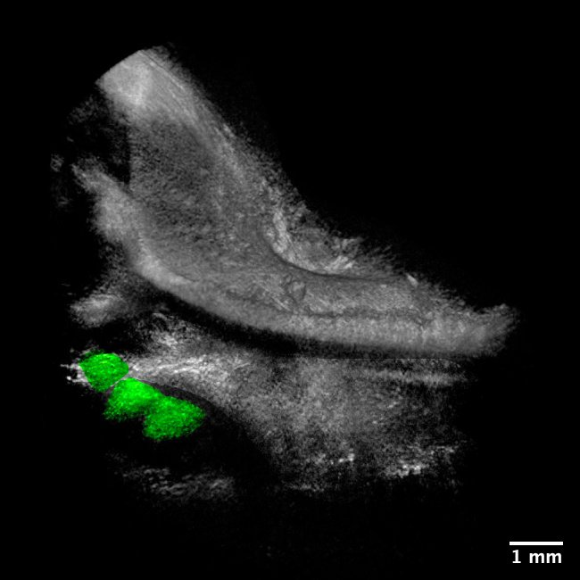
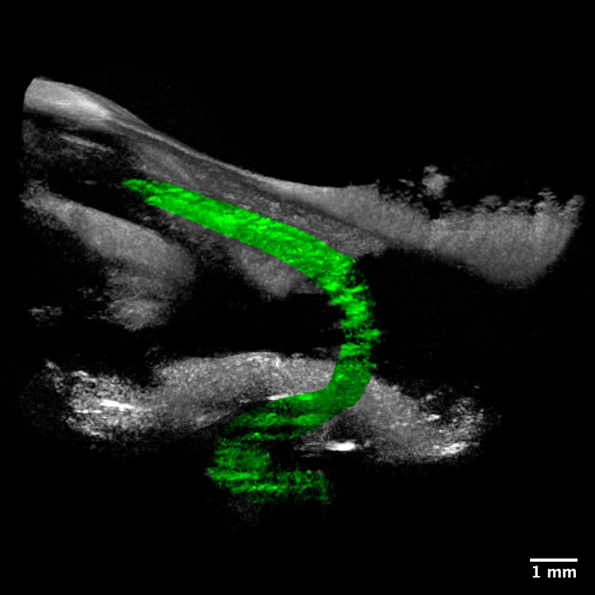






(A) Full Insertion
(B) Partial Insertion I
(C) Partial Insertion II
(D) Complete Migration
(E) Slim Modiolar Electrode
1
white alignment maker
2
three white insertion
depth markers;
distance between white markers – 1mm
3
electrode tip; distance
to most proximal white marker – 18.4 mm
$$y$$
$$x$$
TM
TM
TM
TM
RWN
CP
RWN
RWN
RWN
CP
1
CP
CP
$$x$$
6 mm
$$z$$
2
TM
1 mm
TM
M
TM
I
2
I
ST
ST
TM
I
ST
CP
Umbo
CP
CP
RWN
RWN
RWN
CP
CP
RWN
$$x$$
1.4mm
$$z$$
$$y$$
2.6 mm
3

Slide 8
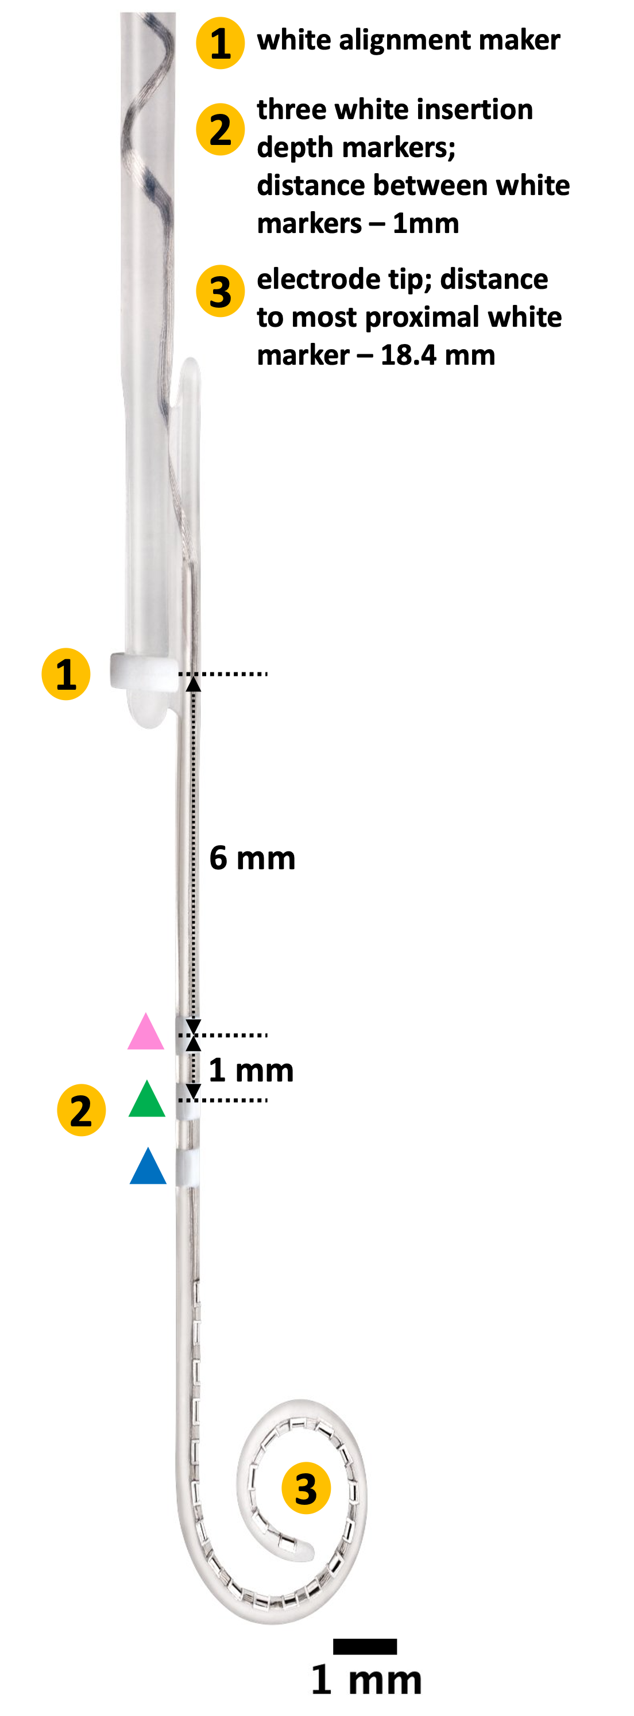
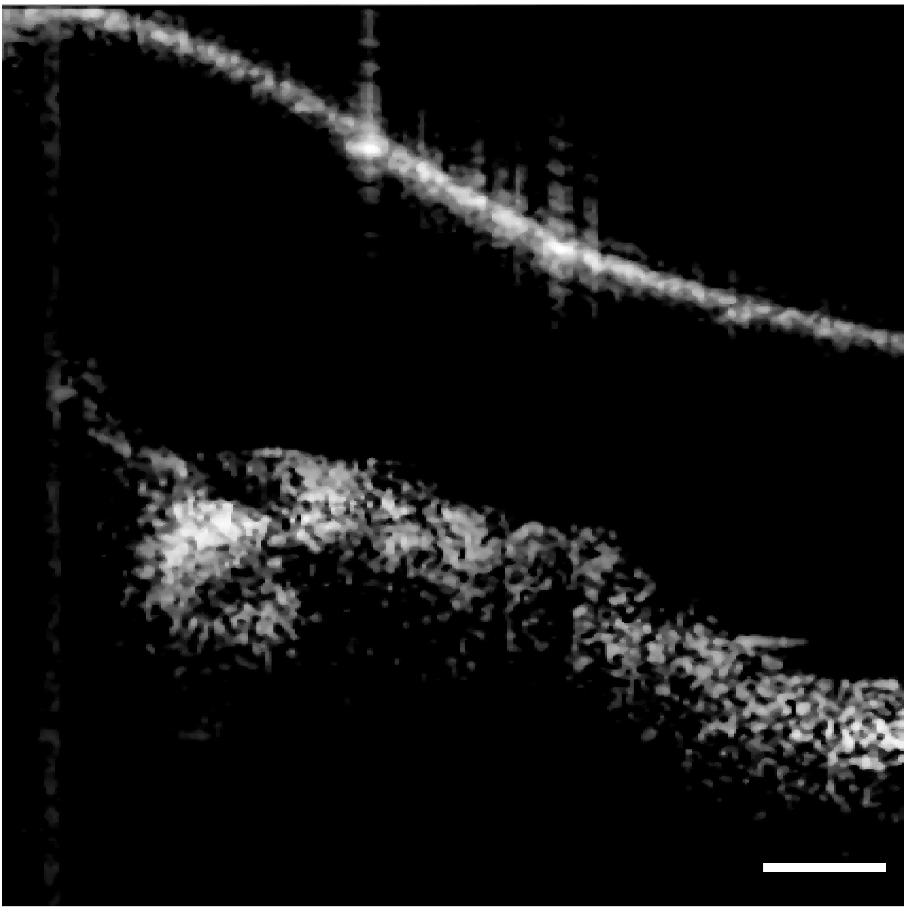
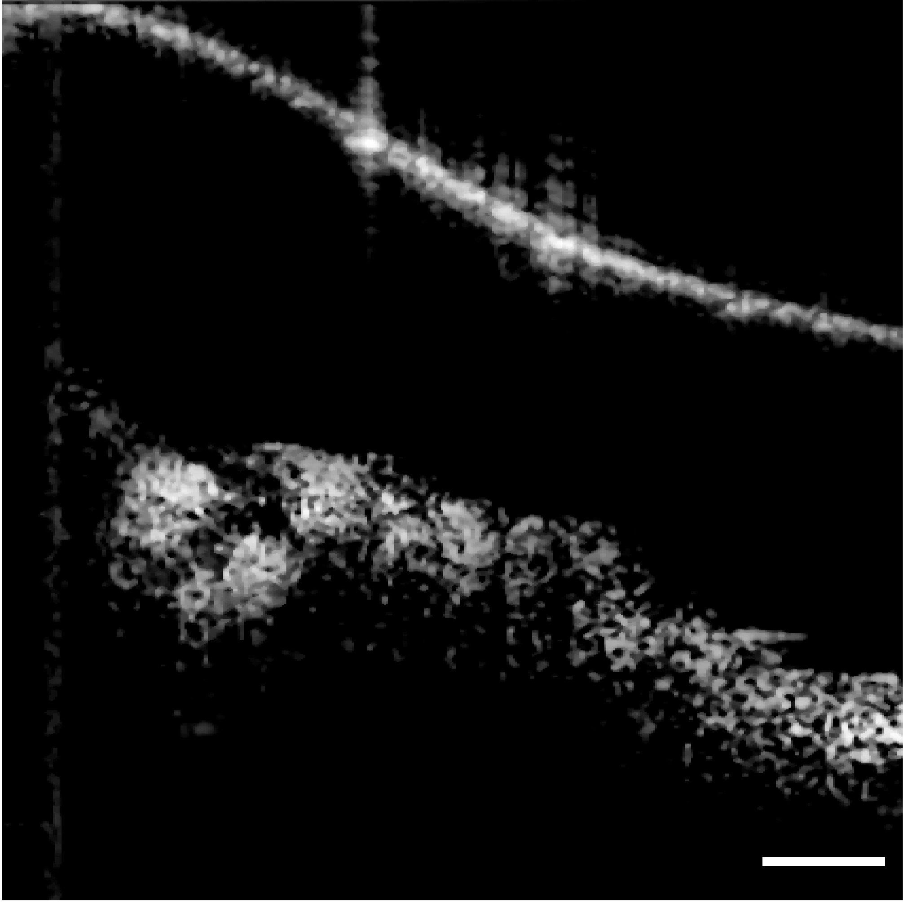
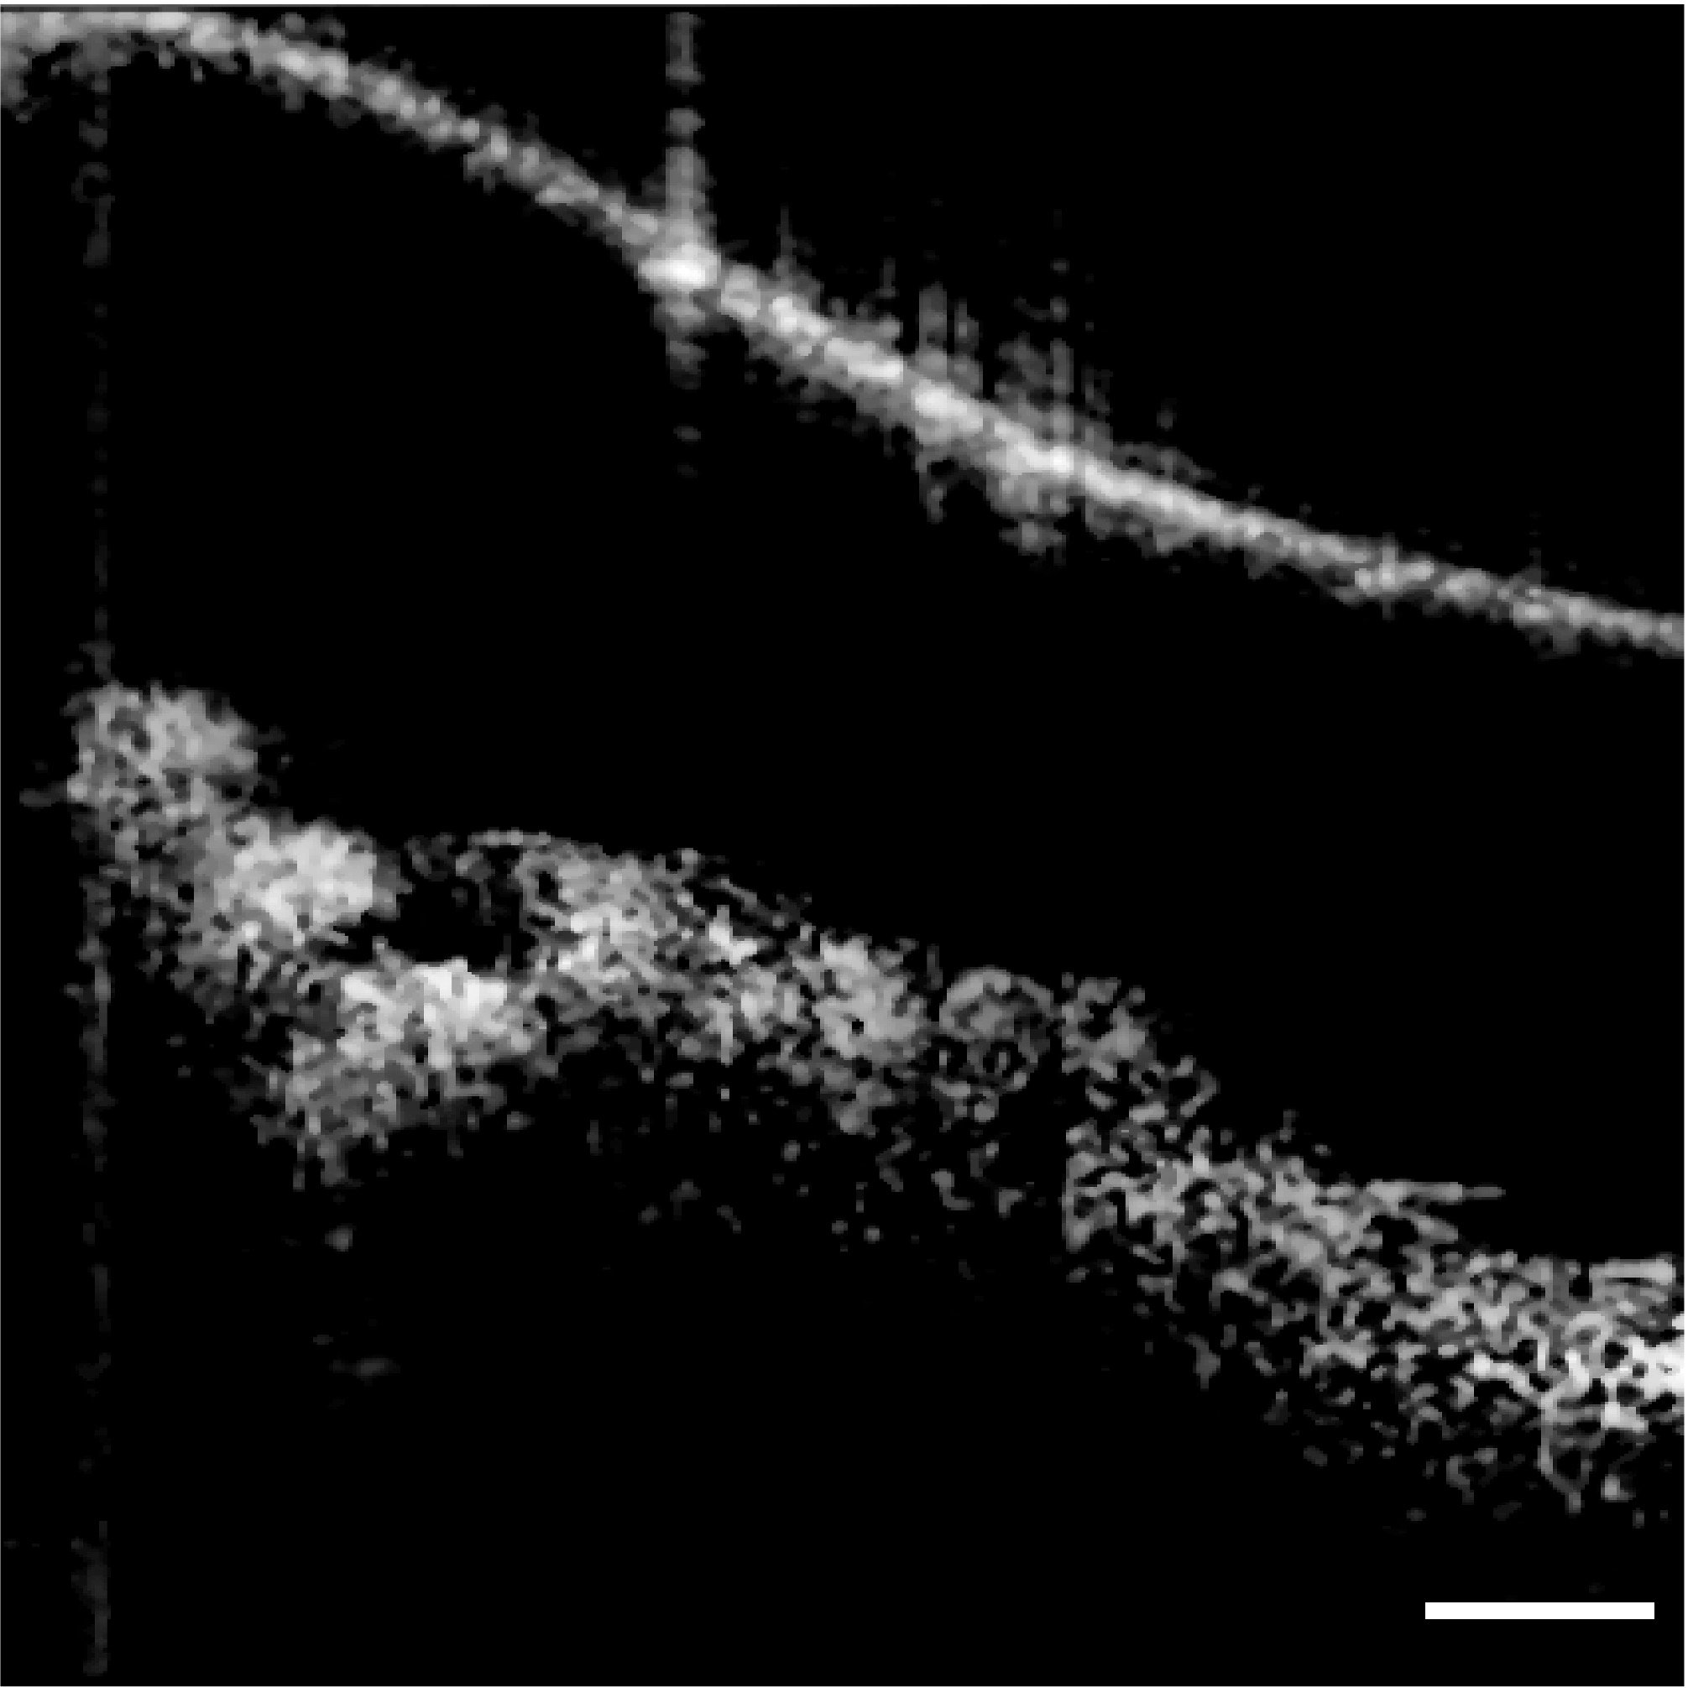
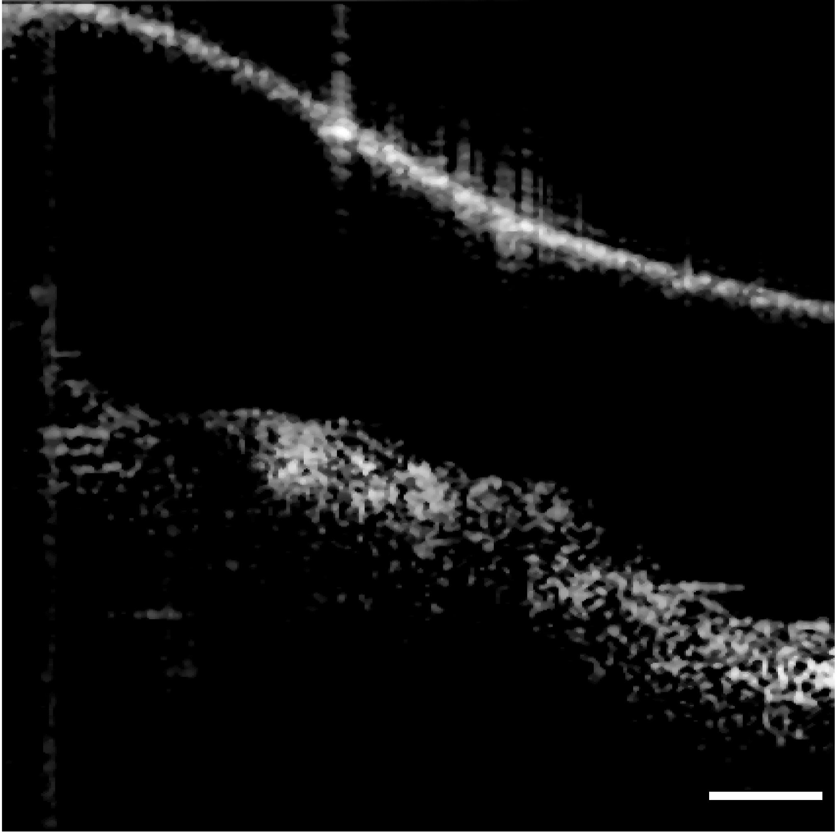
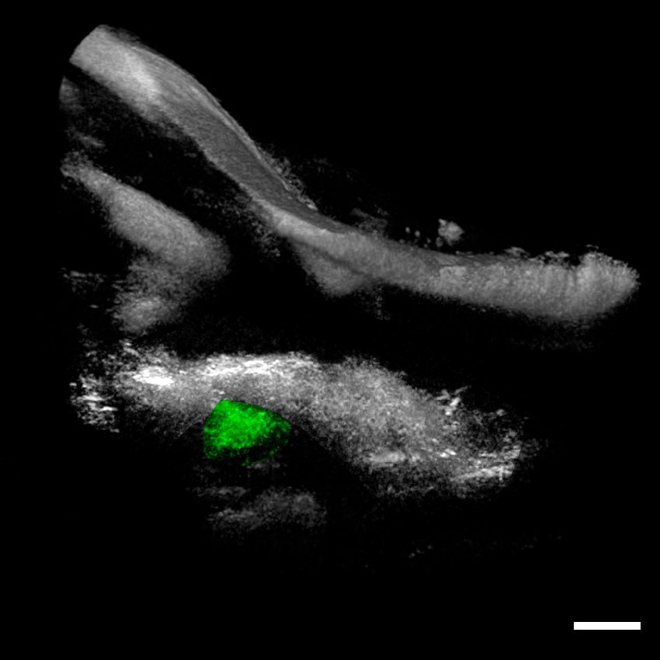
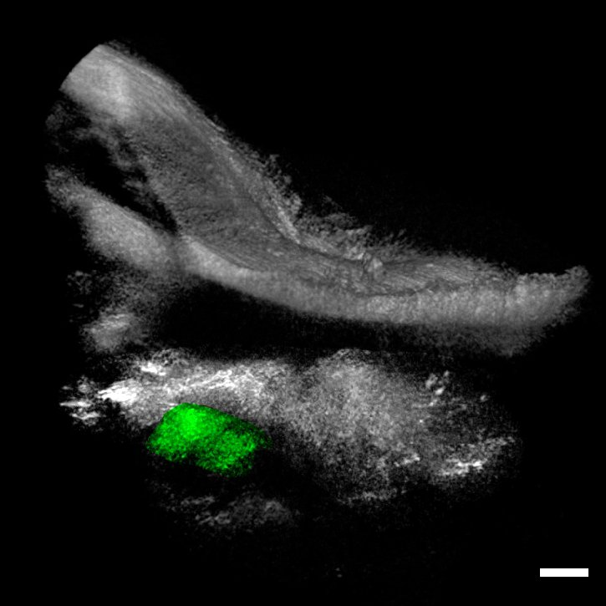
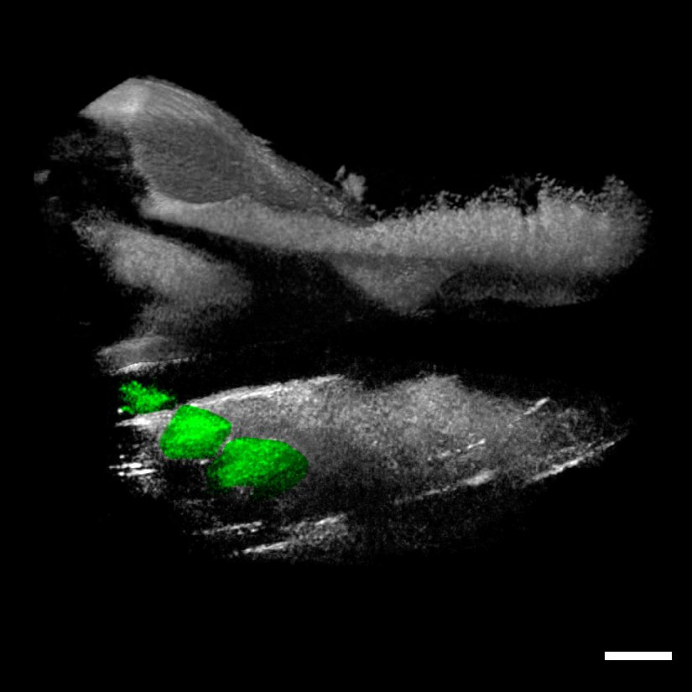
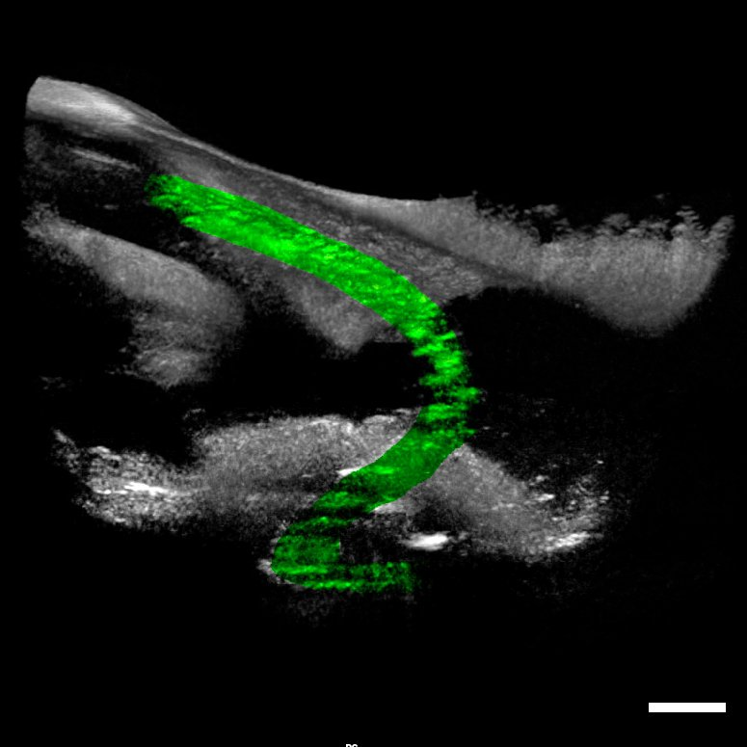

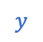





(A) Fully Inserted
(B) Partially Retracted I
(C) Partially Retracted II
(D) Complete Migration
(E) Slim Modiolar Electrode
$$y$$
$$x$$
TM
TM
TM
TM
RWN
CP
RWN
RWN
RWN
CP
CP
CP
$$x$$
$$z$$
2
TM
TM
TM
M
TM
I
I
I
ST
I
ST
U
ST
U
ST
U
CP
CP
CP
CP
RWN
RWN
RWN
CP
RWN
$$x$$
$$z$$
$$y$$

Slide 9


Slide 10



(A) Otoscopic Image
(B) 2D OCT
(C) 3D OCT
(D) CI632
TM
TM
3.5mm
UMBO
CP
CP
RW

Slide 11

(A) Otoscopic Image
(B) 2D OCT
(C) 3D OCT
(D) CI632
TM
TM
3.5mm
UMBO
CP
CP
RW

Slide 12






(C) 3D OCT
(A) Otoscopic Image
TM
$$x$$
$$y$$
$$z$$
1
white alignment maker
1.5 mm
1
$$y$$
U
$$x$$
RWN
CP

Slide 13




(A) Otoscopic Image
(B) 3D OCT
(C) Slim Modiolar Electrode
$$y$$
$$x$$

Slide 14


(A) Otoscopic Image
(B) 3D OCT
(C) Slim Modiolar Electrode
$$y$$
$$x$$

Slide 15















(D) CI632
(A) Otoscopic Image
(B) 2D OCT
(C) 3D OCT
$$x$$
$$y$$
$$z$$
$$y$$
$$z$$
TM
$$x$$
$$y$$
$$∅=45.6°$$
CP
$$∅=45.7°$$
TM
$$z$$
$$y$$
$$x$$
UMBO
3.5mm
RWN
CP

Slide 16


Slide 20


Full Insertion
TM
NO TM
1st Maker

Slide 21


Partial Insertion I(Two marker)
TM
NO TM
1st Maker
2nd Maker
1st Maker
2nd Maker

Slide 22




Partial Insertion I(Two marker)
Before Equalization
After Equalization
equalize_adapthist
rescale
Log
Gamma

Slide 23


Partial Insertion II(Three marker)
TM
NO TM
1st Maker
2nd Maker
1st Maker
3rd Maker
3rd Maker
2nd Maker

Slide 24



Full Migration(electrode)
TM
NO TM(sideview)
electrode
electrode
NO TM(top view)
electrode

Slide 25


Patient CI
TM
NO TM
electrode
electrode

Slide 26



